Slide 1
Teacher instructions / pathway through the lessons
We’re aiming to equip students with knowledge about STIs and how they can be transmitted and treated. We have focussed on some examples and contraception needed to prevent their spread.
Students should learn about HPV as well as this is a focus with the vaccine scheme in the UK.
Explore differences between certain STIs and how easy it is to get tested for them all and treat them.
Notes:
Muhammed Nisaf, Majida Mohammed and Sohaid Radwan are to be withdrawn from this lesson

Slide 2
Do now: Drill questions:
How could a teacher be affected if a pupil is hurt in a road traffic accident?
c. What is a fallopian tube?
d. What is meant by consent?
Witness, trauma, anxiety, PTSD, education levels, needs to help the pupils in the school, support the family.
Tubes joining the ovaries to the uterus.
Saying yes, giving someone permission
Page 47

Slide 3
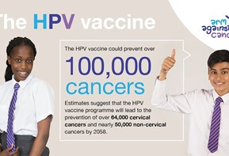
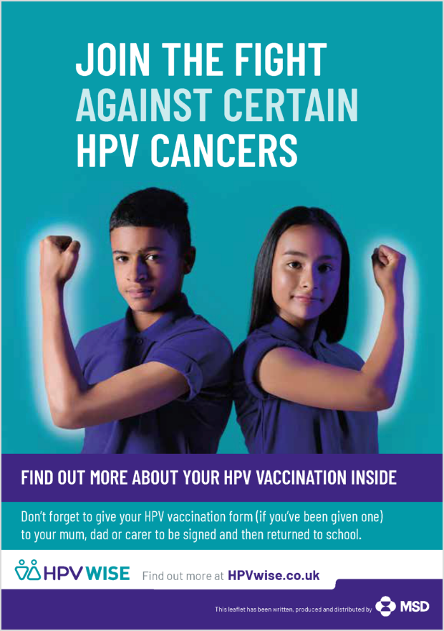
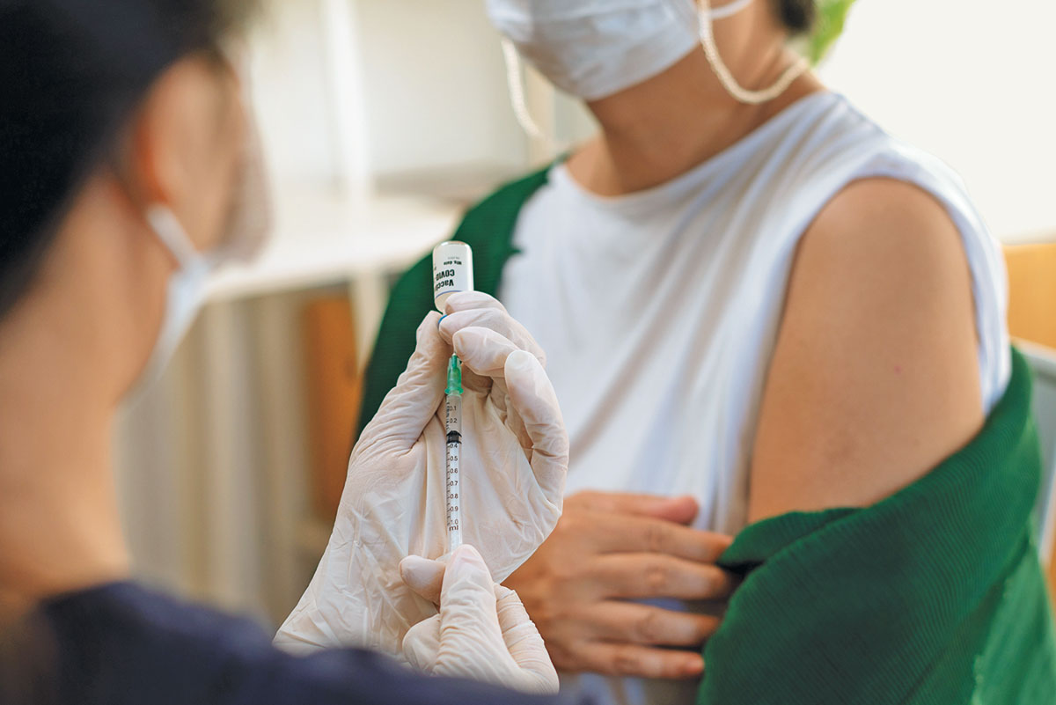
What are we learning today?
How do vaccinations work?
What is HPV?
What does the jab protect me from?
Notes:
By the end of the lesson, students will be able to:

Slide 4
Key words:
is a type of medicine that trains the body's immune system so that it can fight a disease
is when abnormal cells multiply and grow out of control.
Human papillomavirus is a very common group of viruses. Some types can cause genital warts or cancer.
keeping something or someone safe
Protection
Human papillomavirus
Vaccine
Cancer
Page 47

Slide 5
Key words:
is a type of medicine that trains the body's immune system so that it can fight a disease
is when abnormal cells multiply and grow out of control.
Human papillomavirus is a very common group of viruses. Some types can cause genital warts or cancer.
keeping something or someone safe
Protection
Human papillomavirus
Vaccine
Cancer
Page 47

Slide 6
Vaccines can train your body to _______ sicknesses before they even start. They do this by introducing something called an antigen (usually by a needle) into the body, which imitates an _______ and primes the immune system to respond. That way, if you encounter certain disease-carrying organisms, known as pathogens, in the future, your ______ already has a plan of attack.
Vaccines teach your immune system how to create antibodies that protect you from diseases. It's much safer for your immune system to learn this through ________ than by catching the diseases and treating them. Once your immune system knows how to fight a ________, it can often give you life long protection.
prevent
infection
body
vaccination
disease
Page 47

Slide 7
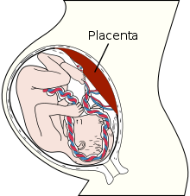
Natural immunity
During pregnancy, antibodies (disease-fighting molecules) pass naturally from mother to baby through the placenta. This movement carries on if the mother decides to breast feed after birth.
Vaccines, for example, expose your immune system to small amounts of pathogens that won't make you sick.
Acquired immunity
Page 48

Slide 8

What is HPV?
What is the year 8 HPV vaccine? | NHS - YouTube
Is the HPV vaccine offered to all sexes?
What year group is it offered?
What does it protect young people from?
How many doses are required?
Both boys and girls
Year 8’s
Numerous cancers. Cancer of the cervix, vulva, penis and anus
1 dose
Page 48
Notes:
Human papillomavirus (HPV) is the name of a very common group of viruses. They do not cause any problems in most people, but some types can cause genital warts or cancer.
Symptoms of human papillomavirus (HPV)
HPV does not usually cause any symptoms.
Most people who have it do not realise and do not have any problems.
But sometimes the virus can cause painless growths or lumps around your vagina, penis or anus (genital warts).
Many types of HPV affect the mouth, throat or genital area. They're easy to catch.
You do not need to have penetrative sex.
You can get HPV from:
any skin-to-skin contact of the genital area
vaginal, anal or oral sex
sharing sex toys
HPV has no symptoms, so you may not know if you have it.
It's very common. Most people will get some type of HPV in their life.

Slide 9
In the first study of its kind, the vaccine was shown to dramatically reduce cervical cancer rates by almost 90% in women in their 20s who were offered it at age 12 to 13.
Cancer research UK predicts that in the future we could begin to see a decrease of HPV related cancer to the point where no one will need a vaccine for it.
Should more young people be made aware of the vaccine that’s on offer?
In 2025 the NHS have changed the routine cervical screening from 3 to 5 years- Is this a good or bad thing in your opinion?
HPV vaccine cutting cervical cancer by nearly 90% - BBC News (youtube.com)
Notes:
After decades of research, the UK implemented a human papillomavirus (HPV) vaccine programme for teenage girls in 2008.
Now, for the first time, a study has shown that the UK HPV vaccine programme works and will save lives, according to research funded by Cancer Research UK.
“The power of science”: HPV vaccine proven to dramatically reduce cervical cancer - Cancer Research UK - Cancer News
In the first study of its kind, the vaccine was shown to dramatically reduce cervical cancer rates by almost 90% in women in their 20s who were offered it at age 12 to 13.
The study, published in The Lancet, shows the potential for HPV vaccination in combination with cervical cancer screening to reduce cervical cancer to the point where almost no-one develops it.
The researchers are based at King’s College London and the UK Health Security Agency (UKHSA) and the National Cancer Registration and Analysis Service (NCRAS) run by NHS Digital. Together, they estimated that the HPV vaccination programme prevented around 450 cervical cancers and around 17,200 cases of precancerous conditions over an 11 year period.
“It’s a historic moment to see the first study showing that the HPV vaccine has and will continue to protect thousands of women from developing cervical cancer,” said Michelle Mitchell, Cancer Research UK’s chief executive.

Slide 10
Measles (MMR)
Many people during COVID-19 didn’t receive their MMR vaccinations at 1 and 3 years old. You need two doses to ensure you are protected. This has meant that we have now seen cases rising in the UK.
Read through the exert in your booklets.
Page 48
Notes:
Measles outbreaks cause alarm: what the data say (nature.com)

Slide 11
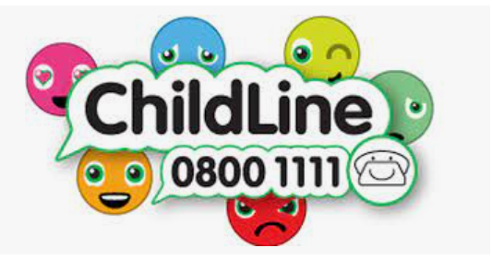
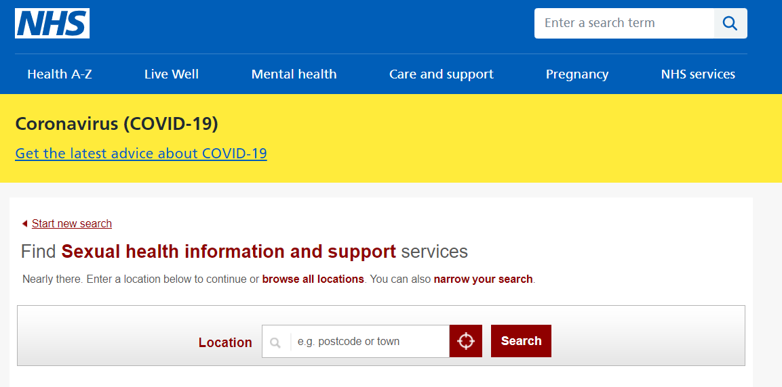



Signposting:
If you have any concerns or worries please speak to a member of the safeguarding team who will be happy to help.

Slide 12
