Slide 1
This lesson is designed to give students another perspective on the impact of prisons on people’s lives and some of the opportunities that they are given.
The resource/ viewpoints are Citizenship based. Previous lessons and the following lesson are actually RE based. The lesson is based in two parts. The first being looking at factors of how we can make people good again and the second studying Norway (who have one of the lowest crime rates in the world) and how they approach how to make people good again
Students will look at how education, housing and work can impact an offenders life when thye get out of prison
Watch the video and then read through how Norway plan to make people good again (reminding students that they have recently studied Anders Brevik who was Norwegian and how they cannot stop everything) answering the questions in the book

Slide 2
Do now: Drill questions
Why did prisons need reforming?
2. What is meant by the term personal conviction?
3. Name one reason why people chose apprenticeships ?
Exam style question
What is meant by the term reformation?
Diseased, dirty, corrupt and lacked education which meant people struggled to get out of prison cycle
A strong belief
Paid/ more time at work/ learning on the job/ reduced time at college
Change the criminal to ensure they do not commit crime again
Page 30

Slide 3

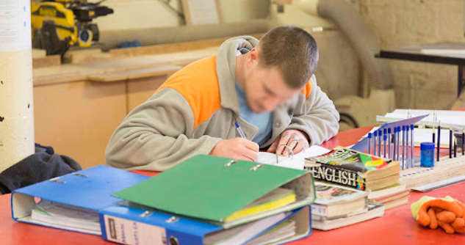

What are we looking at today?
What are the links between education, housing and work and prisoners?
Are prisons really helping?
Next lesson we will look at an alternative – the death penalty.

Slide 4
The Bible says…”Blessed are the merciful for they will be shown mercy.”
“Whoever sheds the blood of man, by man will his blood be shed”
The Qur’an says…. “if you pardon and overlook and forgive, then indeed God is Forgiving and Merciful”
“Nor take life—which God has made sacred except for just cause”
Education
Housing
Prison
Re-offending
Disadvantaged
A place that people are sent for the purpose of punishment
To commit a further offence. E.g. commit another crime after being released from prison.
The act of teaching or receiving knowledge from someone else.
Lacking basic resources/ conditions considered necessary to be in an equal position with others in society.
Houses and flats, accommodation that people can live in.
Page 30

Slide 5
The Bible says…”Blessed are the merciful for they will be shown mercy.”
“Whoever sheds the blood of man, by man will his blood be shed”
The Qur’an says…. “if you pardon and overlook and forgive, then indeed God is Forgiving and Merciful”
“Nor take life—which God has made sacred except for just cause”
Education
Housing
Prison
Re-offending
Disadvantaged
A place that people are sent for the purpose of punishment
To commit a further offence. E.g. commit another crime after being released from prison.
The act of teaching or receiving knowledge from someone else.
Lacking basic resources/ conditions considered necessary to be in an equal position with others in society.
Houses and flats, accommodation that people can live in.
Page 30

Slide 6
Education
Education and work in prison
Courses are normally available to help prisoners get new skills, for example learning to read and write, use computers and do basic maths. Most prisoners get an Individual Learning Plan listing courses and training.
Qualifications and skills
Most courses lead to qualifications that are recognised by employers outside prison, for example GCSEs or NVQs. Prisoners may be able to do a distance learning course, for example Open University.
A prisoner can learn skills, for example woodwork, engineering or gardening.
How does education make people good again?
Why does this matter?
Prisoners have much lower levels of literacy than the general population. The most recent data published by the Ministry of Justice shows that 57% of adult prisoners taking initial assessments had literacy levels below those expected of an 11-year-old.
https://www.youtube.com/watch?v=XBVMjVXAMYw
Page 30
6
Notes:
This video is about re-habilitation of prisoners in general.

Slide 7
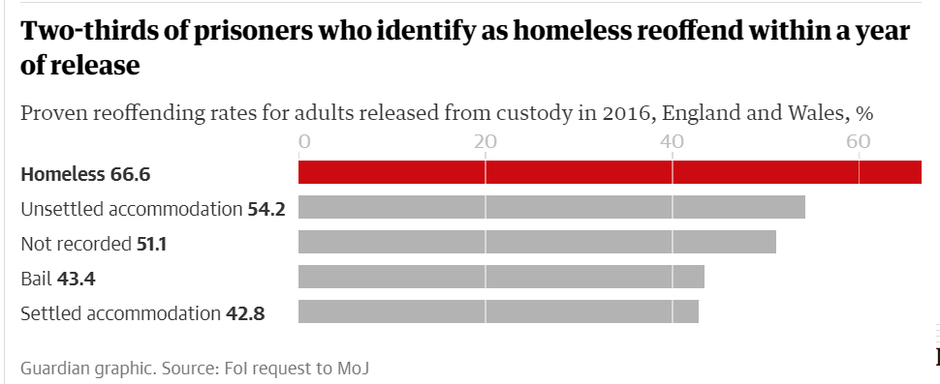
Housing
How does housing make people good again?
Two-thirds of homeless ex-prisoners reoffend within a year | Prisons and probation | The Guardian
Page 30
7
Notes:
Two-thirds of homeless ex-prisoners reoffend within a year | Prisons and probation | The Guardian
You can either print copies of this article / read it through or summarise the points for students.
Who?
Ex prisoners who are homeless when entering/ leaving prison are at increased risk of re-offending. 66.6% of re-offenders are homelss
What?
Homelessness reduction act 2019
Where? UK. Accomodation pilots in Leeds, Pentonville and Bristol
June 2024- 87,726 in UK
n March 2019, the prison capacity in the United Kingdom was said to be 86,473.
At the start of 2020, the prison population had remained relatively constant at between 80,000 and 85,000 during the last decade. The subsequent coronavirus pandemic in 2020-21 saw the prison population drop to 77,896, its lowest figure for many years.
Figures from the Prison Reform Trust's Bromley Briefings factfile give an idea of the costs racking up because of what amounts to a national addiction to imprisonment. The overall cost of the criminal justice system has risen from 2% of GDP to 2.5% over the last 10 years. That is a higher per capita level than the US or any EU country. Each new prison place now costs £170,000 over the life of the accommodation. The cost per prisoner per year is £41,000. The justice committee warns that, on current estimates, the government's new prison plans would condemn it to finding an extra £4.2bn over the next 35 years.

Slide 8
Work:
Employment provides an offender with independence, status, earning power, a structured routine, social contact and a sense of purpose and direction. It has a direct effect on reducing reoffending, cutting the number of crimes committed in our communities.
Employment= paying your rent, money to buy goods (you may have previously stolen), routine of getting up and going to work= less time being pulled into negative stuff.
How does work make people good again?
Helping prisoners back into society - YouTube
Page 30

Slide 9
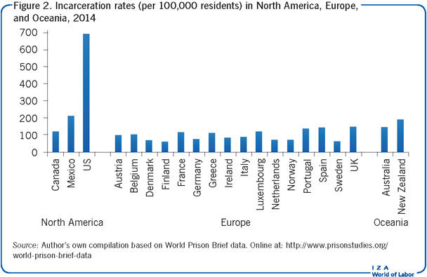
Think, pair and share America has one of the highest incarceration rates in the world and one of the highest reoffending rates too. Why would a country that still has the death penalty, have a high rate of crime?
Notes:
Answers
Death penalty is not a deterrent
Lack of educational opportunities
Availability of guns- accidental murders
Potential discrimination

Slide 10
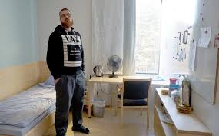
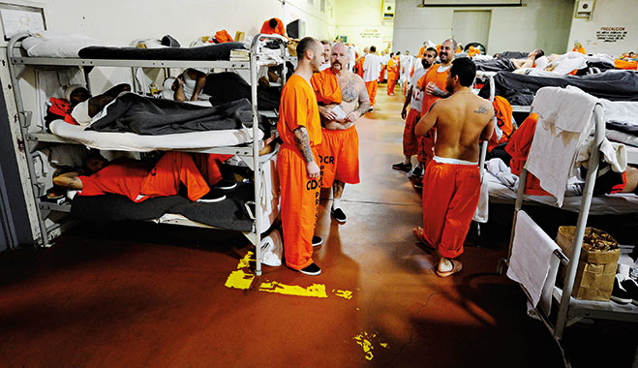
How Norway's Prisons Are Different From America's | NowThis – YouTube
How are Cat A prisons in Norway different?
Why are people less likely to reoffend in Norway compared to the rest of the world?
Page 30
Notes:
Watch the video on the system of Norway’s category A prison (which houses the most dangerous criminals)
Read in booklet about how Norway has such low recidivism rates compared to the rest of the world – if you have time.

