Slide 1
Teacher instructions / pathway through the lessons
The lesson is aimed to encourage students to challenge their views on how they intervene and help.
The lesson is created to help students to think about their own behaviour before we move next lesson onto how we accept toxic behaviour online.
We will look at positive and negative effects of social media and then how that has impacted how we intervene in real life situations.
The bystander effect is a social psychological effect where if more people are around, we are less likely to intervene in situations. This has now been replaced by videoing a situation rather than intervening- this shows empathy for feel individuals and the theme of empathy will follow through to next lesson and how we challenge online toxic behaviour.

Slide 2
Do now: Drill questions:
What is people trafficking ?
What is meant by the term discrimination?
3. What type of debt is a mortgage?
4. What is meant by the term good debt?
Human trafficking is the act of recruiting, transporting, transferring, harbouring, or receiving individuals through force
Unjust or prejudicial treatment of different categories of people
Good debt= investment into where you live
Money will return investment
Page
7

Slide 3
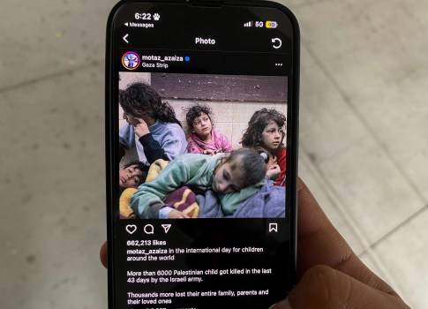

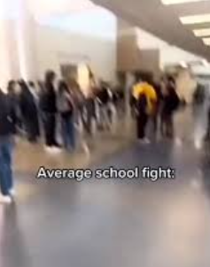

What are we learning today?
What is an algorithm?
How does online activity make us less empathetic?
Are we helping or videoing?

Slide 4
Key words for today
where people are less likely to help a victim when other people are present.
The ability to share someone else's feelings or experiences by imagining what it would be like to be in that person's situation.
Circulated rapidly and widely from one internet user to another.
As instructions that are split into little steps so that a computer can solve a problem or get something done.
Empathy
Algorithm
Viral
Bystander effect

Slide 5
where people are less likely to help a victim when other people are present.
The ability to share someone else's feelings or experiences by imagining what it would be like to be in that person's situation.
Circulated rapidly and widely from one internet user to another.
Are instructions that are split into little steps so that a computer can solve a problem or get something done.
Empathy
Algorithm
Viral
Bystander effect

Slide 6
What is an algorithm?
What is an algorithm?
2. How do algorithms work?
An algorithm shows you content it thinks you want to see based on your previous searches or interactions…
How do algorithms work?
Page
7
Notes:
2- Algorithms are step-by-step sets of instructions, rules, or formulas designed to solve a problem, process data, or perform tasks, acting as a "recipe" for computers.

Slide 7
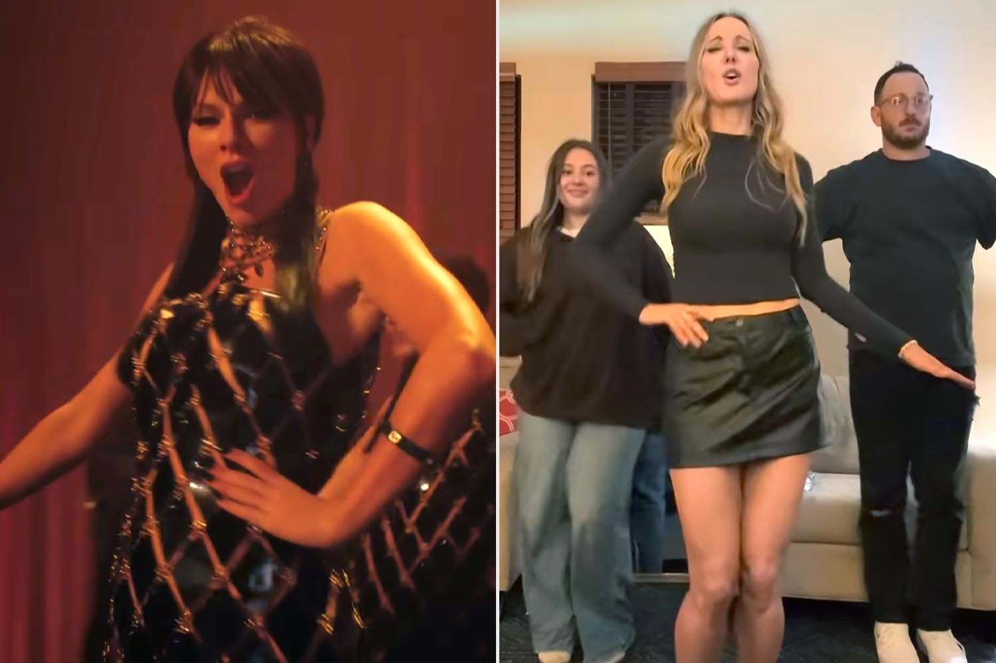
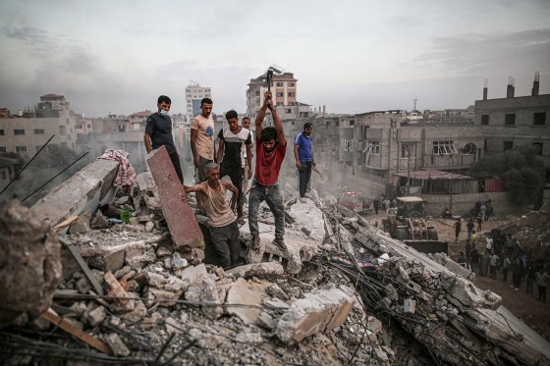
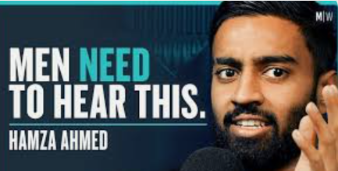
Positive- can be fun, bonding activity
Negative- many life threatening and dangerous challenges have occurred, resulting in death. Pressure and comparisons of one another, inclusion of children in videos and potentially putting them at risk of predators
Social media viral challenges
Positive-allows individuals in areas to share their story, gain more awareness quickly and for free, individuals can put pressure on law and policy makers
Negative- vicarious trauma, viewing trauma can change your mental wellbeing, we view the situation but can do little to help.
3 examples of how social media can be used.
How can each example be used positively and negatively
Awareness of global issues
Page
7
Positive- gives individuals a place to feel heard, can be influencing positively for people.
Negative- will exploit vulnerable people out of money (man on the left charges £770 for subscription on how to be a man), negative influences, comparison of one another.
Social media influencers
Notes:
Teacher knowledge- all social media can have positive and negative impacts.
Answers will fly on the board

Slide 8
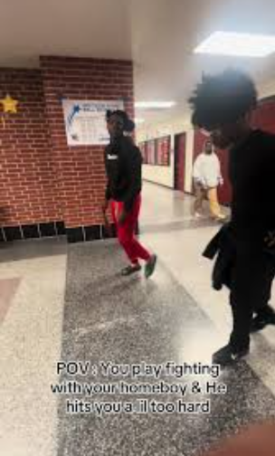
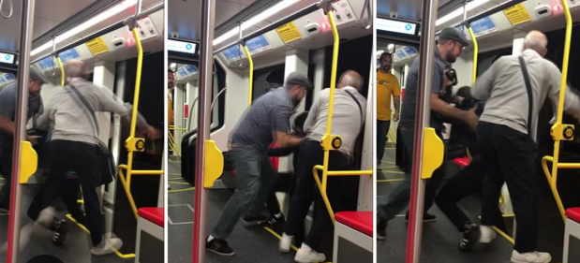
Think, pair and share
Does the internet make is easier to be less empathetic?
The line between reality and online behaviour can become blurred. Some argue that being anonymous on the internet makes behaviours like this more likely. In fact, some people may even have less empathy for individuals in the situation
Notes:
Yes-
we live in a world where we video situations rather than helping (videoing fights after school) and not intervening,
wanting to go viral and looking for likes, social media has enabled us to video situations where individuals need help and avoid our responsibility of helping.
- Perceived lack of consequences of videoing the act- This reduced sense of accountability and the perception of others as "just words on a screen" makes it easier to act without empathy.
- Line between banter and joking has been crossed and we fail to see when individuals need help rather than laughing at them.
We all have a right to be safe and we all have a responsibility to help make sure people are safe.

Slide 9
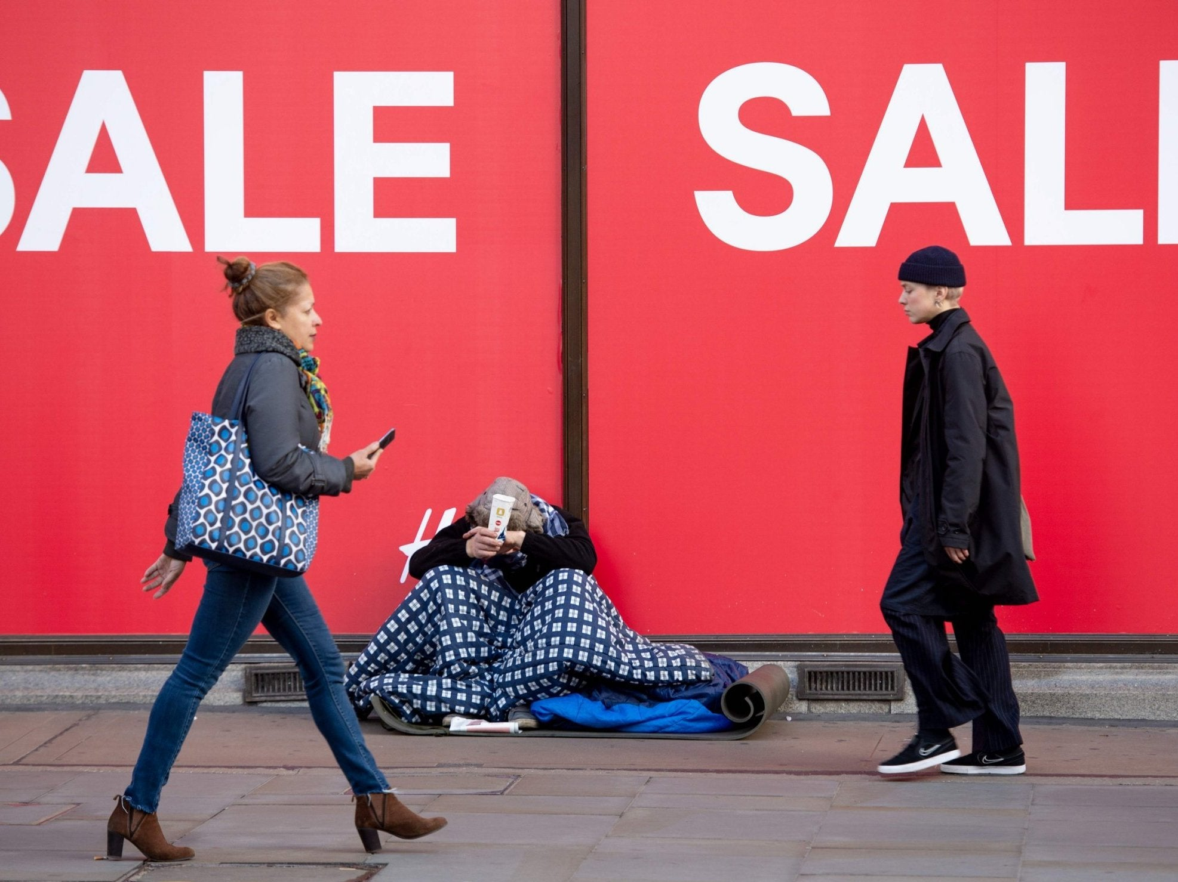
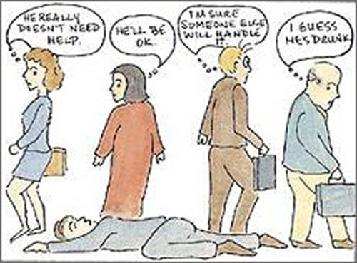
Do we have the same empathy for everyone?
What is the bystander effect?
2. How might clothing or the way an individual presents change our view on if they need help?
where people are less likely to help a victim when other people are present.
It can be seen as one of the reasons why lots of people walk past homeless individuals everyday. We believe they do not need our help
Feel they deserve it and so therefore we do not intervene. If an individual is not well dressed, our brain begins to presume they ‘have done it themselves’. This is called unconscious bias
Page
8
Helping Hands | Brain Games
Notes:
Teacher knowledge- The bystander effect is a social psychological phenomenon where people are less likely to help a victim when other people are present. The greater the number of bystanders, the less likely any single individual is to take action, a process that can be influenced by the ambiguity of the situation, social influence from others' inaction, and a diffusion of responsibility. This can lead to a person in distress not receiving help they might have received if they were alone with a witness.

Slide 10
What would you do…
A fight has broken out outside of school. The two individuals fighting have fallen out and you’re not involved so it’s nothing to do with you.
What’s your next step?
Notes:
Videoing fights happens at OMA. It is a punishable situation.
The right thing to do- call for help/ try to intervene/ encourage others to stop goading the fight
What some people do- video the incident/ cheer even when someone is being harmed/ share the incident on social media/ try to get into camera frames to ‘go viral’

Slide 11
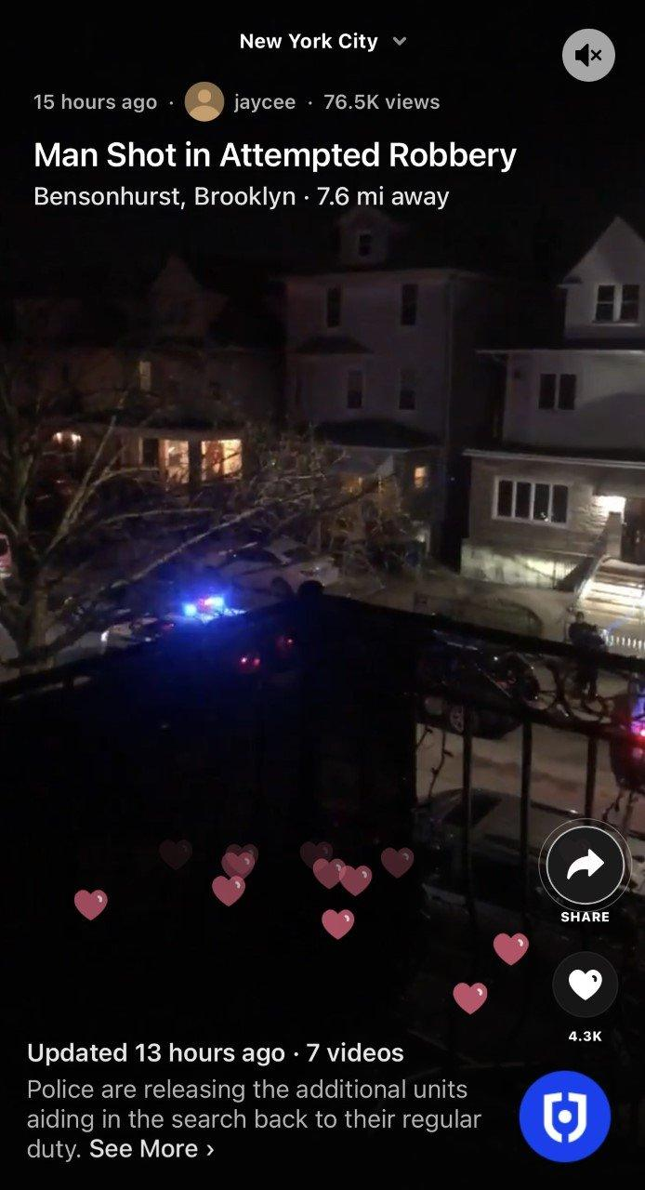
How does the bystander effect play out online?
Why do people film an incident rather than intervening and helping straight away?
2. In the article, it states some individuals are looking for notoriety rather than stepping in and helping. Why might that be?
Fear of being harmed, fear of repercussions in taking a side, doing the right thing isn’t popular, fight/ flight or freeze.
Wanting to go viral, wanting fame and attention.
Page
8
Notes:
2. Read the article in students booklet
3. Answer questions and discuss- answers will pop up
Full article if needed
Do crime apps and viral videos stop bystanders from helping? - BBC News
The Bystander Effect: Why People Film Fights But Don't Stop Them

