Slide 1
Teacher instructions / pathway through the lessons
In this sessions students should begin to understand the idea of consent
The session is aimed to ensure that students are aware of ‘my body my rules’ and that everyone is entitled to their space.
Students should understand that abuse can happen in their relationships as a child and the perpetrator can be another child. This is called child on child abuse
Students will then go through a number of scenarios which may seem ‘normal’ to teenage children but are actually abuse. Answers are in the note section
WHY
Ofsted have recently found a high level of abuse in schools from other children. Particularly, sexual abuse after the killing of Sarah Everard and the rise of Andrew Tate this is something we have seen in our school too
Notes:
Ofsted’s findings from 2021 review on sexual abuse in schools by peers
Review of sexual abuse in schools and colleges - GOV.UK (www.gov.uk)
This rapid thematic review has revealed how prevalent sexual harassment and online sexual abuse are for children and young people. It is concerning that for some children, incidents are so commonplace that they see no point in reporting them. This review did not analyse whether the issue is more or less prevalent for different groups of young people, and there may well be differences, but it found that the issue is so widespread that it needs addressing for all children and
young people. It recommends that schools, colleges and multi-agency partners act as though sexual harassment and online sexual abuse are happening, even when there are no specific reports.
On our visits, girls told us that sexual harassment and online sexual abuse, such as being sent unsolicited explicit sexual material and being pressured to send nude pictures (‘nudes’), are much more prevalent than adults realise. For example, nearly 90% of girls, and nearly 50% of boys, said being sent explicit pictures or videos of things they did not want to see happens a lot or sometimes to them or their peers. Children and young people told us that sexual harassment occurs so frequently that it has become ‘commonplace’. For example, 92% of girls, and 74% of boys, said sexist name-calling happens a lot or sometimes to them or their peers. The frequency of these harmful sexual behaviours means that some children and young people consider them normal.

Slide 2
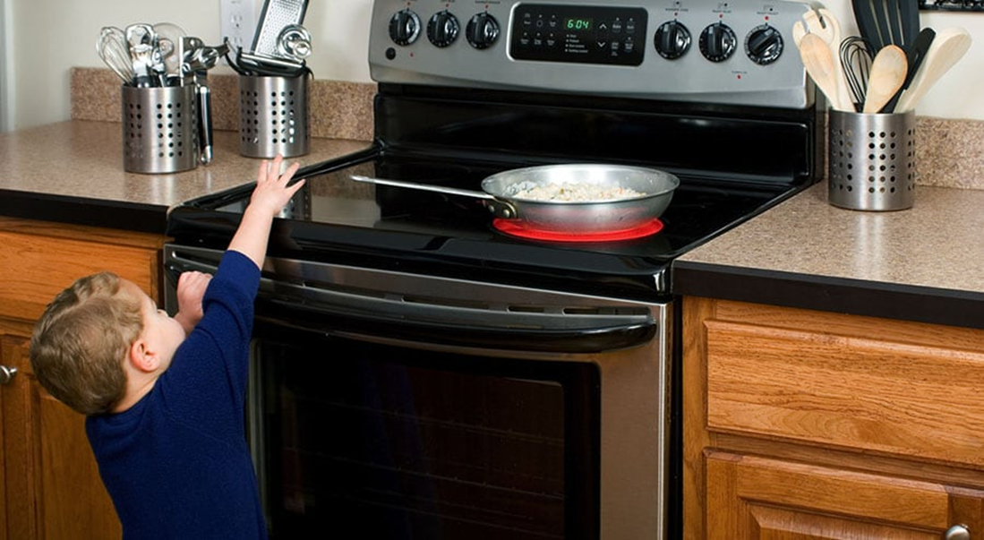
DO now
Page 40
Last lesson:
A. What is the hazard in the image?
B. How can we reduce the risk
C. What is the difference between a risk and hazard
a. Hot cooker, hot pan, hot liquids in pan.
b. Put it on back of hob and handle towards the back.
c. Hazard is something that causes harm: risk is how likely it is.
Exam style question:
What is meant by the term physical boundary? [2 marks]
A boundary that we put in place that is a comfortable distance

Slide 3



What are we learning today?
-What is consent?
What is child on child abuse?
How does peer pressure link to child on child abuse?

Slide 4

We shouldn’t touch anybody without their consent.
We shouldn’t force anybody to do anything without them allowing for us to do it
We should always ask permission before touching another person.
Tea Consent (Clean) - YouTube
Notes:
Watch the video
How does tea link with consent?
Not able to touch someone without asking for their consent and that we shouldn’t force individuals to do anything they wouldn’t want to do.

Slide 5
What is consent and why do I need to know it?
“Consent is an agreement which is given willingly and freely without exploitation, threat or fear, and by a person who has the capacity to give their agreement”
Page 40
Notes:
Read through as a group the definition of consent.

Slide 6
“Consent is an agreement which is given willingly and freely without exploitation, threat or fear, and by a person who has the capacity to give their agreement”
1. Which three words are the most important in this definition?
2. When have you given someone consent to do something?
As you get older and possibly get intimate with someone why is it important for young people to understand what the definition of consent is?
Page 40
Notes:
As a class pick out three most important words. I would pick agreement, freely and willingly. All three words describe what consent is as it should be given to anything without manipulation or coercion
After you have completed the task together. There are two questions for students to answer on why it is important to include consent at such an early age.

Slide 7
Child on child abuse
Child on child abuse occurs when a young person is exploited, bullied and / or harmed by their peers who are the same or similar age; everyone directly involved in peer on peer abuse is under the age of 18
Notes:
Key questions to ask class
1. Have you ever hurt someone accidentally because you thought it was a joke but they didn’t like it?
2. Could you hurt each other?
3. What could be the impacts of hurting one another? (feeling low, feeling left out or hurt)
4. Why is it important to raise awareness of children hurting each other.

Slide 8
What is child on child abuse?
Taking inappropriate images of each other
Bullying
Physical abuse – hitting, nipping, kicking, biting, burns and slapping
Sexual abuse – forced kissing, pressure to become a couple
Sexual touching without consent
Abuse in a friendship
Page 40
Notes:
Child-on-Child Abuse | The Education People
Students to need to write different examples down in their book

Slide 9
A number of scenarios are going to come up and we will try to look out what type of abuse is happening in the scenario.

Slide 10
Scenario 1 – I do
Jacob has just started a relationship with Demi, he really likes her but she keeps nipping him and hitting him. She says that it’s a joke but she's been doing it for weeks. He’s told her that he doesn’t like it but she just carries on.
This is an example of physical abuse
Page 41
Notes:
Physical abuse

Slide 11
Scenario 2 – I do
Aaron and Layla have been dating for a few months, they’re both 15 but recently Aaron wants to have sex and keeps touching her without her permission, she doesn’t like it and has told him but he said if she tells anyone he will just make up a rumour about her.
This is an example of sexual harassment and manipulation
Page 41
Notes:
Difference between harassment and assault
Sexual assault happens when someone touches another person in a sexual manner without their consent.
Sexual harassment is any unwanted sexual behaviour that makes someone feel upset, scared, offended or humiliated, or is meant to make them feel that way.
Manipulation in relationships
If someone consistently makes you feel emotionally drained, anxious, fearful, or doubtful of your own needs, thoughts, and feelings, you may be dealing with emotional manipulation. Follow your gut instinct when it comes to recognizing what is occurring while also looking for these signs of manipulation in a relationship:
Gaslighting
Passive-aggressive behavior
Lying and blaming
Threats and coerciveness
Withdrawal and withholding
Isolation

Slide 12
Scenario 3
Ayman is friends with Ali and Ayman knows that Ali is involved with a street gang but Ayman always stays away from that stuff. Ali has started to buy him expensive gifts and tell him that the lads want to meet him.
Ayman is being groomed by Ali to encourage him into the gang
Page 41
Notes:
What is grooming?
Grooming is when someone builds a relationship, trust and emotional connection with a child or young person so they can manipulate, exploit and abuse them.
Children and young people who are groomed can be sexually abused, exploited or trafficked.
Anybody can be a groomer, no matter their age, gender or race. Grooming can take place over a short or long period of time – from weeks to years. Groomers may also build a relationship with the young person's family or friends to make them seem trustworthy or authoritative.
Whether online or in person, groomers can use tactics like:
pretending to be younger
giving advice or showing understanding
buying gifts
giving attention
taking them on trips, outings or holidays.

Slide 13
Scenario 4
Molly and Danielle are best friends and Molly has a Saturday job. Danielle always pressures Molly into buying pizza every Saturday for her and the group of friends. Molly doesn’t want to say no because Danielle said that she would start a rumour about her kissing a boy if she refuses.
Financial abuse and manipulation
Page 41
Notes:
Here are some examples of this exploitation:
Controlling or spending your money: This may involve trying to control your use of or access to money you have earned or saved. They may also use your assets for their personal benefit without asking, including taking money or using credit cards without permission.

Slide 14
Scenario 5
It’s a windy day and all of the girls skirts are blowing up. Ben decides to take a photo of the row of girls in front and you can see their bums, he sends it to his mates in a group chat for a laugh. They won’t find out.
Upskirting- this is an illegal crime and if found guilty can result in 1-2 years in prison
Page 41
Notes:
'Upskirting' is an informal term for a type of voyeurism when someone uses equipment like a camera or mobile phone to take photos or videos underneath a person's clothes, without their permission. If found guilty of an upskirting offence, you may receive a summary conviction with a sentence of up to 1 year in prison and/or a fine. Those found guilty of a serious offence in the Crown Court may be imprisoned for up to 2 years.

Slide 15
Scenario 6
Ryder and Jack are brothers, Ryder is 16 and Jack is 14. Mum doesn’t like Ryder’s friends and says that their bad news but she can’t do anything because she works late at Co-op. Ryder sometimes gets Jack to drop parcels off at his mates house and gives him £20. Jack just wants to stay at home on Fifa with his mates but Ryder said he has to go because he’s his brother.
Emotional abuse and manipulation
Page 41
Notes:
Emotional abuse involves controlling another person by using emotions to criticize, embarrass, shame, blame, or otherwise manipulate them. While most common in dating and married relationships, mental or emotional abuse can occur in any relationship—including among friends, family members, and co-workers.
In this case the emotion being exploited is love

Slide 16
Scenario 7
Neve keeps getting added into a group chat with two other girls in her class, they always say nasty things to her in school but online they keep threatening to kill her. She’s screenshotted the images but doesn’t know how to make it stop.
This is an example of harassment. Any threat of harm could lead to 5 years in prison
Page 41
Notes:
Criminal Harassment
It is a criminal offence for anyone to make you reasonably fear for your safety or the safety of someone you know by...
repeatedly following you or someone you know
repeatedly contacting you or someone you know by any means including in-person, in writing, over the phone or by text or email
watching somewhere where you or someone you know is
engaging in threatening conduct towards you or someone in your family
No actual injury need occur. The offender does not need to have intended to harm you. If their behaviour would cause a reasonable person to fear for their safety, it is criminal harassment.
It is a criminal offence for anyone to threaten to...
kill or cause bodily harm to any person
damage, destroy or burn property
kill, poison or injure any person's animal or bird
The maximum penalty for threatening death or bodily harm is 5 years imprisonment. The maximum penalty for uttering threats to damage property or kill or injure animals is 2 years.

Slide 17
