Slide 1
Do now: Drill questions
What is the design argument
2. Name one example of moral evil
3. What is meant by the term atheist
4. Name one example of natural evil
Exam style question: What is meant by the term child-on-child abuse
The design argument believes that everything has a designer. It poses the question of who designed us
The holocaust, school shooting- any evil that is man made
Do not believe in a God
Hurricane, typhoon, earthquake- an evil act caused by Earth
Abuse towards a child perpetrated by a child
Page 20

Slide 2
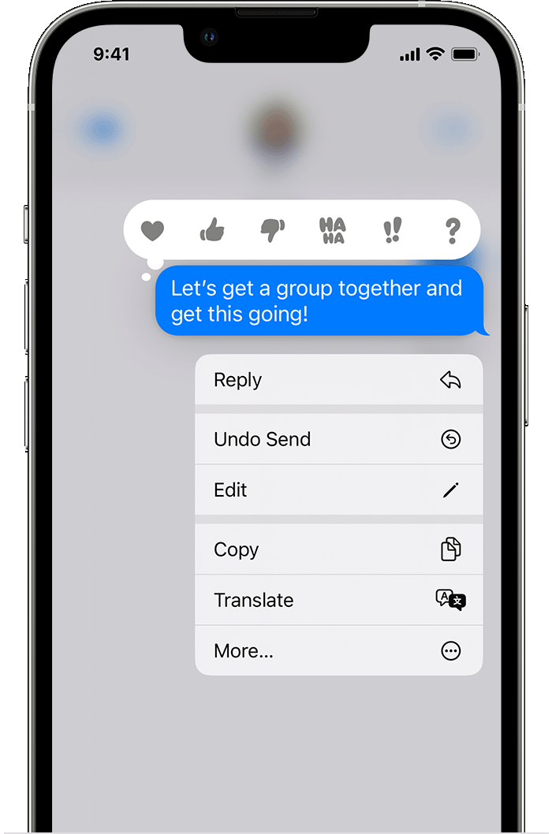
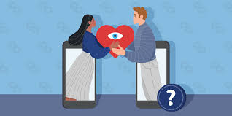

What are we learning today?
What is sexting?
Why would someone send an inappropriate message?
What is sextortion?

Slide 3
Key words:
Are images/media that may have been manipulated by AI to unrealistically impersonate somebody.
Is a type of online blackmail. It is when people threaten to share sexual pictures, videos or information about you unless you pay money.
websites and applications that enable users to create and share content or to participate in social networking, e.g. Facebook or Tiktok.
sending and receiving sexual messages through technology (phone, computers, games consoles etc…). This can just be words or can be extended to pictures and videos.
Sexting
Deepfakes
Sextortion
Social media
Page 20

Slide 4
Key words:
Are images/media that may have been manipulated by AI to unrealistically impersonate somebody.
Is a type of online blackmail. It is when people threaten to share sexual pictures, videos or information about you unless you pay money.
websites and applications that enable users to create and share content or to participate in social networking, e.g. Facebook or Tiktok.
sending and receiving sexual messages through technology (phone, computers, games consoles etc…). This can just be words or can be extended to pictures and videos.
Sexting
Deepfakes
Sextortion
Social media
Page 20

Slide 5
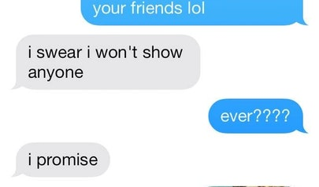

What is ‘sexting’?
‘Sexting’ is a combination of sex and texting. It may also be known as ‘sending nudes’.
Sexting is sending and receiving sexual messages through technology (phone, computers, games consoles etc…). This can just be words or can be extended to pictures and videos.

Slide 6

Aren’t we too young to learn this…?
The NSPCC recently conducted a study and found of the primary school children surveyed, 1 in 20 had been sent a naked or semi naked image by another young person. Of the secondary school children surveyed, 1 in 8 had been sent or shown a naked or semi-naked image by another young person.
Page 20
Notes:
children-sending-receiving-sexual-messages.pdf (nspcc.org.uk)

Slide 7
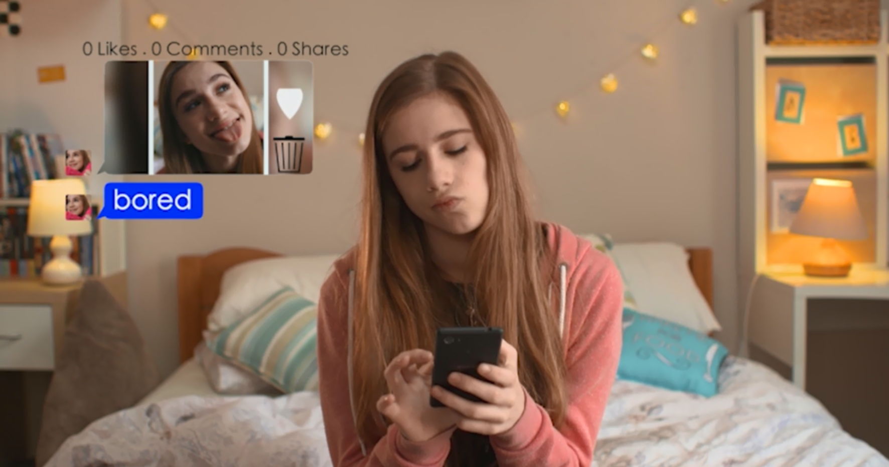
We are going to watch a 6 minute video about a young girl, Abi, who experiences an incident around ‘sexting’.
After the video we will spend some time discussing it watch closely!
http://www.childnet.com/resources/pshetoolkit/sexting/just-send-it
Notes:
Let students watch fully without pausing – may wish to watch twice?

Slide 8
Initial Impressions
Is this story realistic?
Where was the ‘line crossed’?
Why does Josh mention possible involvement from the police at the end of the film? Who do you think broke the law in this film?
Page 20
Notes:
1. Realistic because this sort of thing happens all of the time within schools
- possible answers: when Josh asked for the photo? When Abi sent the photo? When Brandon shared the photo?
3 – we will be looking at the law later on the lesson but all 3 of them broke the law.

Slide 9

The Law – Time to Vote
You are about to see some statements.
You need to vote for if you think they are true or false
Page 21
Notes:
Teachers may wish to use mini whiteboard, or have students stand up/sit down, or move to alternative sides of the room or hands up for agree/disagree.

Slide 10

True
You have to be careful about what you post online/social media/over private messages, because it could be against the law.
There are many laws that incorporate the online world, so there are lots of risks of breaking laws.
Page 21

Slide 11
True
If a child under 18 sends a full or partial naked picture of themselves to someone else, it is against the law.
This law is in place for safeguarding and child protection. The police will take a ‘common sense’ approach and focus firstly on the victim (the person in the photo/video). In certain circumstances, this can results in a criminal record.
Page 21

Slide 12
True
If a child under 18 forwards on a naked picture of someone to embarrass or upset them, there could be serious legal consequences.
This law is in place for safeguarding and child protection. The police will take a ‘common sense’ approach and focus firstly on the victim (the person in the photo/video). In certain circumstances, this can results in a criminal record.
Page 21
Notes:
Discussion points- Sending/ passing on an image of a person under 18 is classed as distribution of child pornography. This could in fact place people on the sex offenders register which would dictate their whole lives e.g. jobs/ where they can and can’t go/ when having their own children

Slide 13

Sextortion- What is it?
Is a type of online blackmail. It is when people threaten to share sexual pictures, videos or information about you unless you pay money. The law also covers threats involving AI and deepfakes*.
Sextortion is a serious criminal offence. It is a form of non-consensual intimate image abuse. Domestic abuse act 2021
You are going to see two scenarios where sextortion has taken place and will decide what you would do if it happened.
Notes:
Please remind students that this is a crime and so they can call the police (101) to help. They can talk to a teacher who will pass to a DSL.
It is not the victim’s fault and they are not to blame.

Slide 14
Scenario 1: What do I do if…
Jay is 15 and met “Trish” online. They have a conversation on Snapchat. After a while, Trish asks Jay to add her on his social media (insta / WhatsApp/ Facebook) and they continue their conversation for a bit longer however it becomes sexual in nature. “Trish” offers to send a pic in return for getting one back from Jay. A pic arrives on Jay’s phone, and at first he is unsure, but “Trish” keeps on encouraging him, tells him he’s really fit and that she fancies him, and she progresses to asking for a live video/videochat. Jay agrees and posts a video of himself naked. Within minutes of Jay sending the video to Trish, Jay receives a message with a screenshot of all his friend groups on a range of social media sites, and a threat from Trish that the video will be shared unless the victim pays , and she demands that he share his bank details or downloaded payment app such as paypal or Revolut/vouchers for Apple or Steam/ask for Bitcoin.
What would you do?
Page 21
Notes:
These approaches are very professional in nature with the aim of blackmailing and the potential distribution of images; 2. Be careful who you accept invitations from; do not get lured into compromising situations. Trust your instincts and end uncomfortable situations and conversations immediately; 3. Remember that what goes online may stay online; 4. Update you social networking privacy settings – only let people you know see your account and don’t include personal or private information in profiles.

Slide 15
Scenario 2: What do I do if...
Sarah is 14 and meets Matthew online. They chat for a while on Snapchat and after about half an hour Matthew asks Sarah to add him on her social media (insta / WhatsApp/ Facebook) and they continue their conversation for a bit longer however it becomes sexual in nature. Matthew offers to send a pic in return for getting one back from Sarah but Sarah refuses. A pic arrives on Sarah’s phone which has Sarah’s face superimposed on a sexual image and a demand for payment otherwise the image will be shared with all Sarah’s friends because Matthew has been able to capture their details from Sarah’s social media sites that she shared with him.
What would you do?
Page 22
Notes:
Do NOT panic. You have already taken the first big step by recognising you are the ‘victim’ in this and the police can get involved.
Do NOT pay.
Do NOT communicate further with the offenders
Block the offender
If you have already paid, check to see if the money has been collected. If it has, and if you are able, then make a note of where it was collected from. If it hasn't, then you can cancel the payment - and the sooner you do that the better.

Slide 16


