Slide 1
Teacher instructions / pathway through the lessons
WHY
COUNTY LINES IS THE LARGEST GROWING CRIME IMPACTING YOUNG PEOPLE
IMPORTANT TO UNDERSTAND HOW GROOMERS WORK TO KEEP YOUSELF/OTHERS SAFE. Vulnerable people are exploited / manipulated. Students should also be completing a county lines session with James Edmonston TBC
The focus should be around the idea that people who are exploited by dealers for county lines are vulnerable. Whilst money might seem appealing in the short term. The money is unlikely to last. This is a link to the Leicestershire police ebay site. This is where the products that have been confiscated from proceeds of crime are sold. They have sold over 6000 items | eBay
What are county lines?[drugs] | Movement of drugs from one major city to another Finding ‘quieter areas’ to sell more drugs Using children/younger people as they are less likely to be stopped and searched | What are county lines How do gangs exploit young people How dangerous are county lines? Laws around county lines

Slide 2

Page 18
Do now: Drill questions:
State 1 reason why antibiotics are prescribed and are not freely available.
b. Why is antibiotic resistance a problem?
c. State 2 symptoms of alcohol addiction.
d. What type of drug causes, increased energy, mood
swings, risk of heart attack? Opioid /Stimulant/ hallucinogen
Exam style question:
Explain one reason why people use drugs [2 marks]
Notes:
Students should have approx. 5 mins to answer the drill questions in their booklets.
The exam style question is linked to the style of questions that the GCSE’s taught by Growth team have. The content is not.

Slide 3
Page 18
Do now -answers:
State 1 reason why antibiotics are prescribed and are not freely available. They need to be controlled as there are over 100 types, antibiotic resistance is also a potential problem.
b. Why is antibiotic resistance a problem? As antibiotics are used more widely, infections are becoming immune to the effects of antibiotics, things that could be cured could become life threatening.
c. State 2 symptoms of alcohol addiction. Putting alcohol above everything else, drinking more than 14 units per week, not feeling able to function without alcohol.
d. What type of drug causes, increased energy, mood swings, risk of
heart attack? Opioid /Stimulant/ hallucinogen
Explain one reason why people use drugs [2 marks] People might use drugs to affect the way that they feel, for example to relieve pain, they may use an opioid.
Notes:
Students will need to self assess their work. They should not be copying down the correct answers. A simple tick or cross is sufficient.

Slide 4
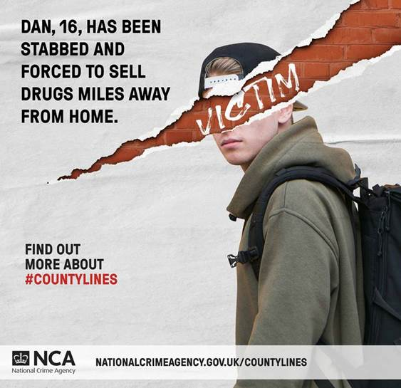
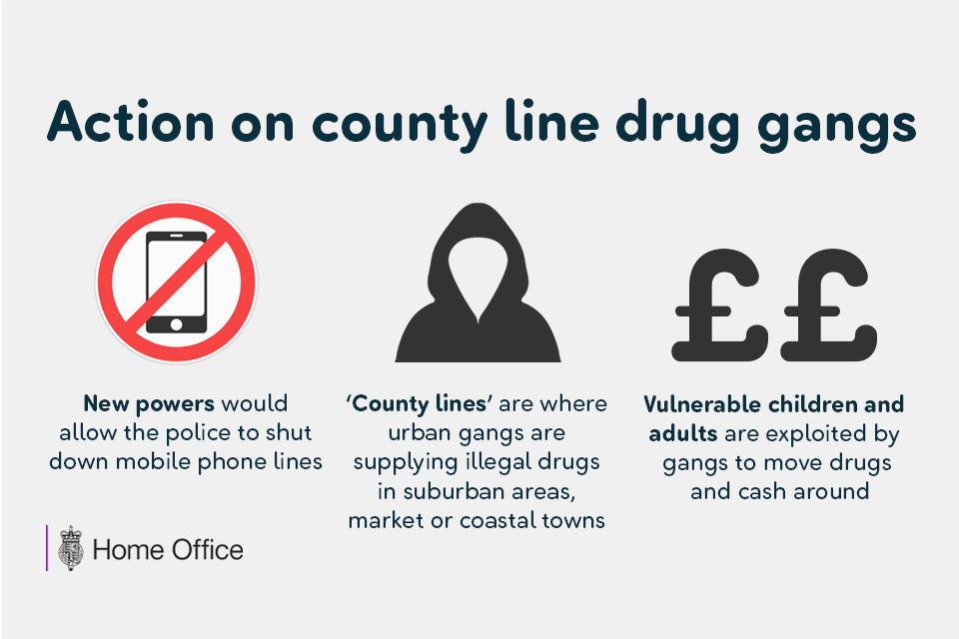
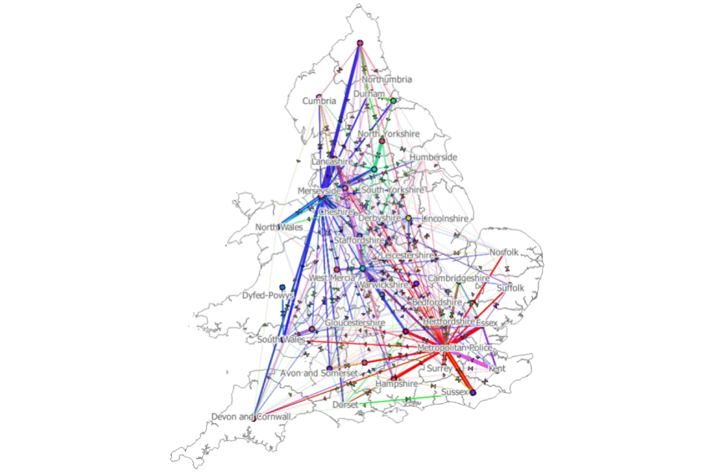
What are we learning today?
What are county lines?
How do county lines gang recruit young people?
How can we stay away from county lines?

Slide 5
Key words:
When a vulnerable person’s house is taken over by a drug dealer and becomes a trap house.
This refers to when someone owns a mobile phone specifically for the purpose of running and selling drugs.
where illegal drugs are transported from one area to another.
The place from which illegal drugs are sold
County Lines
Trap house
Cuckoo
Trapline
Page 18

Slide 6
Key words:
When a vulnerable person’s house is taken over by a drug dealer and becomes a trap house.
This refers to when someone owns a mobile phone specifically for the purpose of running and selling drugs.
where illegal drugs are transported from one area to another.
The place from which illegal drugs are sold
County Lines
Trap house
Cuckoo
Trapline
Page 18

Slide 7
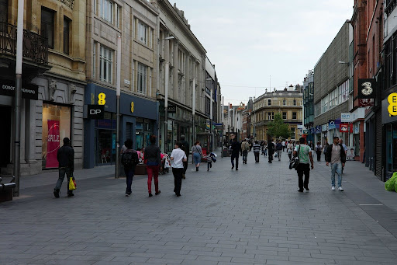

Daniel may face a large competition due to the amount of burger shops down his street and that could lead his business to fail.
Daniel wants to start his own business.
He wants to create a burger takeaway but the street he has chosen to run his business already has 6 burger shops.
Will his business succeed or fail? Why?
Notes:
The aim of this slide is about introducing the business model behind county lines.
Many major drug dealers move out of major cities because there is so much competition so therefore they can make more profit in smaller towns/ cities that have fewer existing ‘businesses’
The answer is on the next slide

Slide 8
Drug dealers operate the same business model. Drug dealers move out of the large areas (typically with a lot of drug dealers) like London, Birmingham, Leicester and move into smaller remote places with less drug dealers. This is called county lines Running The Lines - YouTube
Page 18
Watch the video and complete the questions in your booklet.
Notes:
Running the lines – running time approx. 10 minutes. There is no dialogue in the film.
Brief events of the clip:
Text messages exchanged
Phone and package handed over, the dealer seems jovial and treats the teenager like a mate
Evan has new trainers and a new watch.
Hands over the package to a student.
The dealer shows violence and a darker side when an addict approaches them.
The dealer meets up with Evan again, gives him some train tickets and another package. Evan tries to say no but he is intimidated
Running the Lines – Evan’s Story – YouTube
The above link is to the words of Evan played by an actor. The background to the characters experiences in running the lines.

Slide 9
Running the lines
1. How did the drug dealing start?
2. Did the young boy know that he was delivering drugs?
3. How was the drugs transported across the country?
Offered money
No
Trains
Page 18

Slide 10
Drug dealers groom individuals who tend to be more vulnerable.
What kind of factors could make a child or young person vulnerable?
Siblings and parents active in gang
Family break down
A child in care
Mental health issues
Poor attendance
Special educational needs
Financial issues in home
Siblings or parents in prison
Page 18
Notes:
Give students a few minutes to complete the task in their booklets, the answers are then animated to appear individually when clicked.

Slide 11
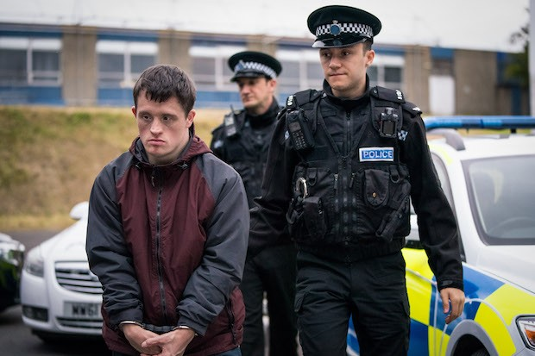
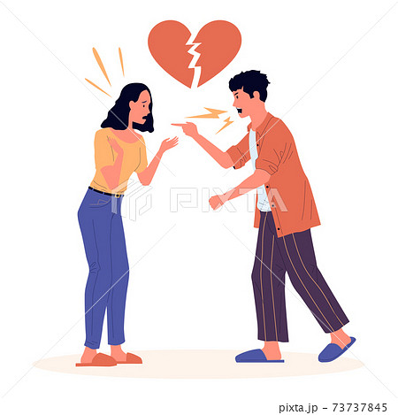
In your booklets are two case studies of vulnerable people. Read through the case study and identify what makes the individual vulnerable and how they were exploited
Case study 1-
Case study 2-
Page 19
Notes:
Info from student booklet:
Case study 1- Jacob is a 27 year old man who lives alone in his flat. He was so happy to have his own place but struggles a little bit due to Down’s syndrome, he can become quite lonely.
He goes to the shop everyday to pick up milk and bread, and to see his favourite cashier. One day, Jacob meets Joe on his way home and Joe mentions to him that he's homeless and needs somewhere to stay. Jacob asked if Joe wanted to stay at his home for a night, later that evening many of Joe’s friends arrived and forced Jacob to stay in his room and if he left, he would be killed.
1. What is Jacob’s vulnerability?
Disability – down syndrome
2. What has happened to Jacob’s house?
He has become cuckood- cuckooing the practice of taking over the home of a vulnerable person in order to establish a base for illegal drug dealing, typically as part of a county lines operation.
3. How was Jacobs vulnerability exploited?
Due to his disability, Joe took advantage of his good nature and exploited it to take over his home to sell drugs and turn his home into a trap house
Case study 2- Nic’s parent are going through a rough patch, they seem to be arguing a lot more than usual. Nic hates raised voices and conflict so leaves the house every time they argue. He usually walks to the local park to play basketball. He always sees a group of kids around the court but doesn’t usually talk to them, until one day a boy called Ryan asked if he was ok because he's seen him around here a bit on his own. Ryan was a few years older and asked him questions about his life. Over a few months Ryan and Nic become good friends and Ryan introduced him to his friends who don’t work but seem to have really expensive clothes on. Nic doesn’t mind because they let him chill at their house when his parents are arguing.
1. What is Nic’s vulnerability?
2. Are there any concerns with Nic and Ryan’s friendship?
3. How could Nic’s vulnerability be exploited?

Slide 12
COVID-19: County lines victims 'younger and female' - YouTube
However, county lines drugs dealers can also make people vulnerable through the use of love.
How did the dealer begin a relationship with Alisha?
How was Alisha coerced into moving drugs?
Stretch: Why do you think the county lines victim model is changing?
Notes:
Video synopsis:
Report from sky news about how COVID increased the vulnerability of young people with regards to county lines
- When Alisha was 14 years old she was contacted by an 18 year old on snap chat, they met and he seemed nice.
Smoked weed together, she owed him money for the weed and he owed someone else the money. He suggested she worked for him.
She wanted to stop once she had paid the money back but was afraid, she had seen others become the victims of violence. People sat outside her house.
She wasn’t given train tickets, she was told to jump the trains
She was ‘delivering’ items locally at first – weed and coke in a bag.
Alisha’s boyfriend introduced her to another man, he wanted her to deliver weapons. He was higher up in the gang so she felt protected. She was made to have sex and was afraid to say no.
She wanted to leave the gang but was afraid.
COVID lead to a change in the County lines model, victims are becoming more affluent and more likely to become female. They are victims !

Slide 13
1. How did the dealer begin a relationship with Alisha? They started ‘talking’ over Snapchat. Alisha was 14 and the dealer was 18.
2. How was Alisha coerced into moving drugs? Alisha started smoking weed with her ‘boyfriend’, this meant that she then owed him money. Moving the drugs meant that she was able to begin to pay him back.
Stretch: Why do you think the county lines victim model is changing?

Slide 14
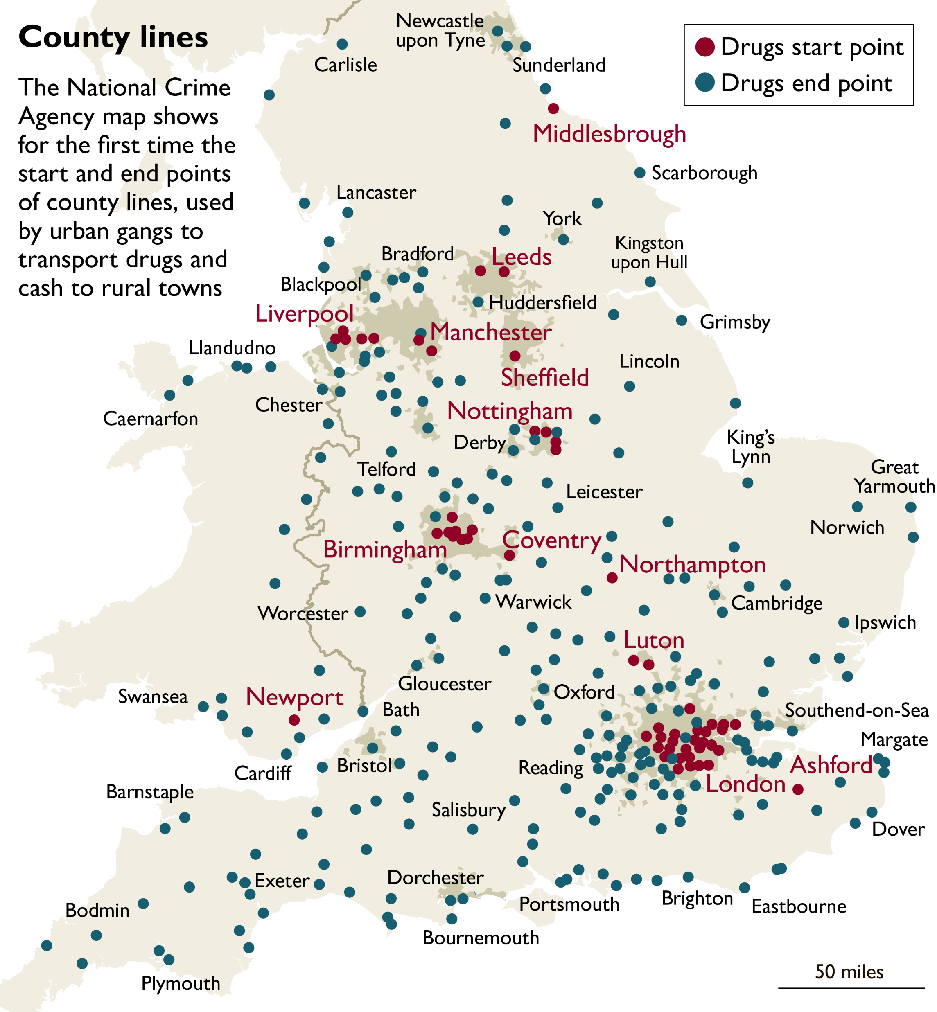

How to keep safe
Nothing is free.
If a stranger offers you something for free it probably isn’t.
2. If its too good to be true. It probably is…
Online or via friends (quick money usually has the longest consequences)
3. Tell your teacher, Miss Lowe, HOY or AHOY

Slide 15


Signposting:
Protecting children from county lines and exploitation | NSPCC
County Lines Support and Rescue | Catch22

