Slide 1
Teacher slide
The lesson is designed to show students where to apply for jobs and how to apply for roles.
You will first look at where- indeed and then how
I have added notes onto the bottom of the PP to guide you through my thinking behind the slides and lesson.

Slide 2
Do now: Drill Questions
What is one skill developed by baking?
Name one example of a job website
3. Define the term ‘extremism ’
Exam style question
What is meant by the term time management
Creativity, time management, improvisation and following instructions
Indeed
the holding of extreme political, social or religious views.
Managing time effectively to meet deadlines
Page 7

Slide 3



What are we learning today?
What is a job?
How do I get a job?
Why is it important to look at careers in Yr9?

Slide 4
Key words for today
Job
Application
Advertisement
CV
Used by employers to attract potential employees
Curriculum vitae is a summary of your skills, achievements and experience that you use to apply for jobs.
used by employers to gather information about potential employees
a paid position of regular employment.
Page 7
Notes:
Students need to match up the key words in their booklet. This will only take a couple of minutes

Slide 5
Key words for today
Job
Application
Advertisement
CV
Used by employers to attract potential employees
Curriculum vitae is a summary of your skills, achievements and experience that you use to apply for jobs.
used by employers to gather information about potential employees
a paid position of regular employment.
Page 7
Notes:
Students need to match up the key words in their booklet. This will only take a couple of minutes

Slide 6



What are the most common recruitment methods?
Advertisement | These are the methods used by employers to attract potential employees and encourage them to apply for a specific job role.
Application | These are the methods used by employers to gather information about potential employees to identify which applicants best meet the requirements of the role.
Interview | These are the methods used by employers to further assess a job candidate’s suitability for a role by evaluating their skills, qualities and experience.
We started to look at advertisements last lesson and job specification
Today, we will begin to look at application process and how to create a CV
Notes:
Teacher exposition:
Recruitment methods can be grouped into three categories:
Advertisement methods: These are the methods used by employers to attract potential employees and encourage them to apply for a specific job role.
Application methods: These are the methods used by employers to gather information about potential employees to identify which applicants best meet the requirements of the role.
Interview methods: These are the methods used by employers to further assess a job candidate’s suitability for a role by evaluating their skills, qualities and experience.

Slide 7
After you have seen a job role that interests you. You will need to start the application process. In your booklets number the points in the correct order
Apply for the position. They could ask for a cover letter
Wait to hear back from place of work.
Look for a job either on a website like Indeed or see a vacancy in a window or advertisement board
Arrive for the interview
Sign an employment contract
Accept or decline the role
Create a CV
3
5
2
4
7
6
Page 7
1

Slide 8
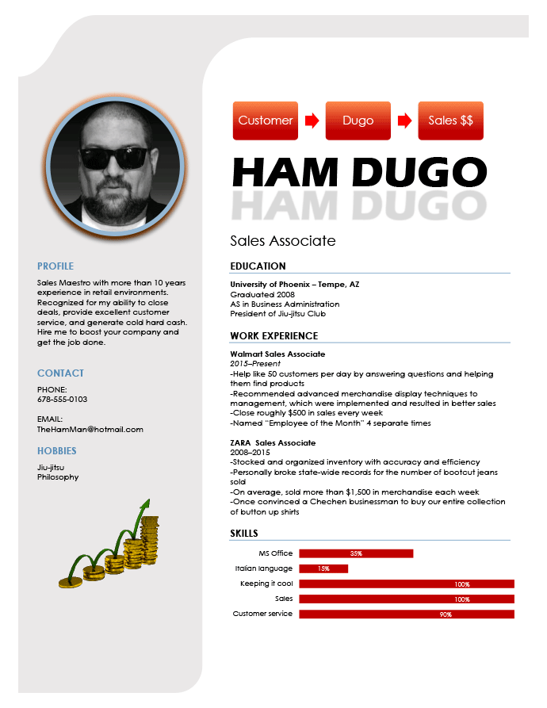
What is a CV?
Watch the video
After watching the video, what may be wrong with the CV example on the right
What is a CV?
Notes:
After watching the video, ask students to speak to the person next to them on issues wit the CV on the board – Think, pair and share
Issues-
Unnecessary and distracting graphics like the ones in this example are an easy way to make your resume look unprofessional and (in some cases) bizarre.
flashy graphics distract from your resume’s goal of clearly communicating your skills and accomplishments.
software can’t process the graphics on your resume, then hiring managers might miss key information.
Graphics can become a serious problem when applying to companies that use software to automatically scan through job applications

Slide 9
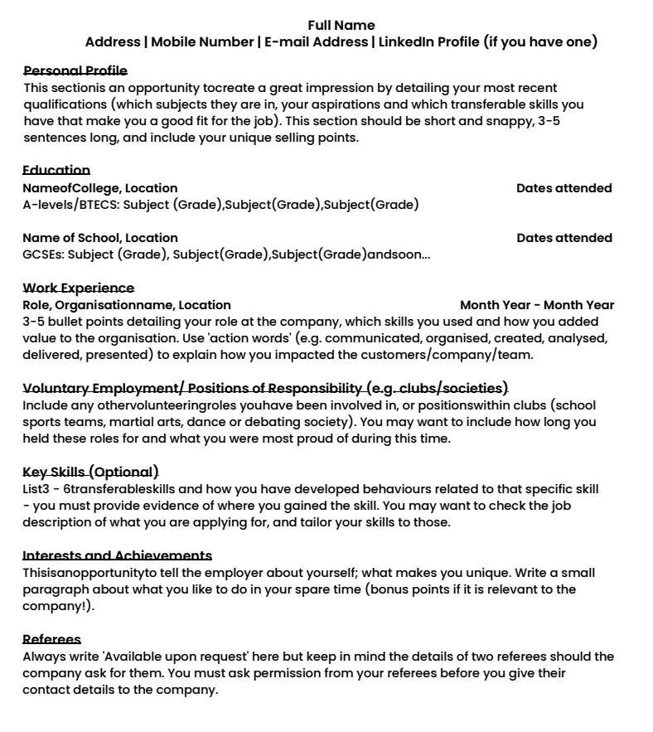
Name at the top and then address
2. Personal statement- a little bit about yourself/ skills and attributes that you hold
This is a CV.
Everyone needs one to apply for a job.
Around your CV please annotate the key points
3. Education- your most recent education should be first
4. Experience- As you are young, you may have little experience. You can use this space for work experience or things that you have taken part in
5. Key skills you hold and how you developed the skill
6. References- all jobs require you to give a reference. You can ask the school to give you a reference
Page 8
Notes:
Ask students to add in key annotations around their CV. This task should take 10 minutes; this should be done as a group with teachers narrating the why to students on each point.

Slide 10
Progress check Question Your own CV
Name:
Personal Statement:
Education:
Experience:
Interests and achievements:
References:
Communication, hard worker, problem-solving, creative, computer skills, adaptability, leadership and attention to detail
In this box, write a little bit about yourself. How would you describe yourself. You can use skills and attributes already on the screen.
You should add the GCSEs you would like to take next year.
You will need to pick 3 GCSE courses.
Taking part in extra-curricular such as sports clubs, volunteering, projects you have helped with.
How did these experiences benefit you?
In this box, you should write any experience you may have had. Employers will know that you will have had little work experience due to your age.
If you have no experience, lean on your interests
Page 9
Notes:
This is the PROGRESS CHECK QUESTION – All students must complete this task and then you will mark and give feedback on it. Mark sheet is on the next slide for teacher use. Students will gain a mark if the information is included and not based on explanation.
The aim is they just need to include the information, and we will build on perfecting their CV over the next 2 years.
Ask students to complete their own CV. This task should take around 15/20 minutes. For personal statement students can use attributes and skills they have picked out from lesson 1 in the booklet.

Slide 11
Progress check question- marking
Name | 1 mark
Personal statement | 1 mark
Education | 1 mark
Experience or interests If students do not have any experience, please award them a mark for personal interests | 1 mark for experience – can be anything like DofE, volunteering for clubs or taking part in extra-curricular 1 mark for interests- this can be hobbies and skills they have developed from them.
References Must include 1 example, this can be a teacher in the school | 1 mark
Page 9

