Slide 1
Do now: Drill Questions
1.Organise the following into needs and wants
Electric bill
New outfit
Rent
Phone contract
2. Name one reason why someone may struggle to save money
Page 4

Slide 2
Do now: Drill Questions
1.Organise the following into needs and wants
Electric bill
New outfit
Rent
Phone contract
2. Name one reason why someone may struggle to save money
Already in debt, outgoings are more than income, unemployed
Page 4

Slide 3


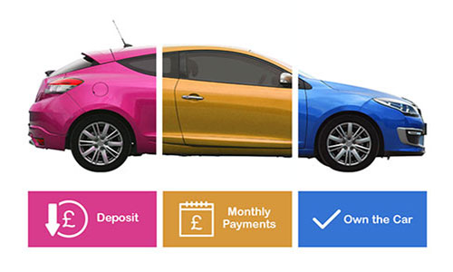
What are we learning today?
What is debt?
What are the different types of debt?
How easy is it to get into debt?

Slide 4
Key words for today
Bad debt
Good debt
Debt
Financial education
the ability to understand and use various financial skills, including personal financial management, budgeting, and investing.
A sum of money owed or due
usually planned with a clear purpose for investing. It is generally linked to a return on that investment.
a debt that cannot be recovered.
Page 4

Slide 5
Key words for today
Bad debt
Good debt
Debt
Financial education
the ability to understand and use various financial skills, including personal financial management, budgeting, and investing.
A sum of money owed or due
usually planned with a clear purpose for investing. It is generally linked to a return on that investment.
a debt that cannot be recovered.
Page 4

Slide 6
What is debt?
Something
A debt is when one person owes . In financial terms, this can be someone owing the bank . However, if the person in debt doesn’t pay back, there is usually a because of not paying back. We will all be in debt at some point, whether that is paying for a or purchasing a car on hire purchase. Managing finances and ensuring there is enough money will make the of debt easier.
Money
Consequence
Mortgage
Stress
Mortgage | Money | Consequence | Something | Stress
Page 4

Slide 7
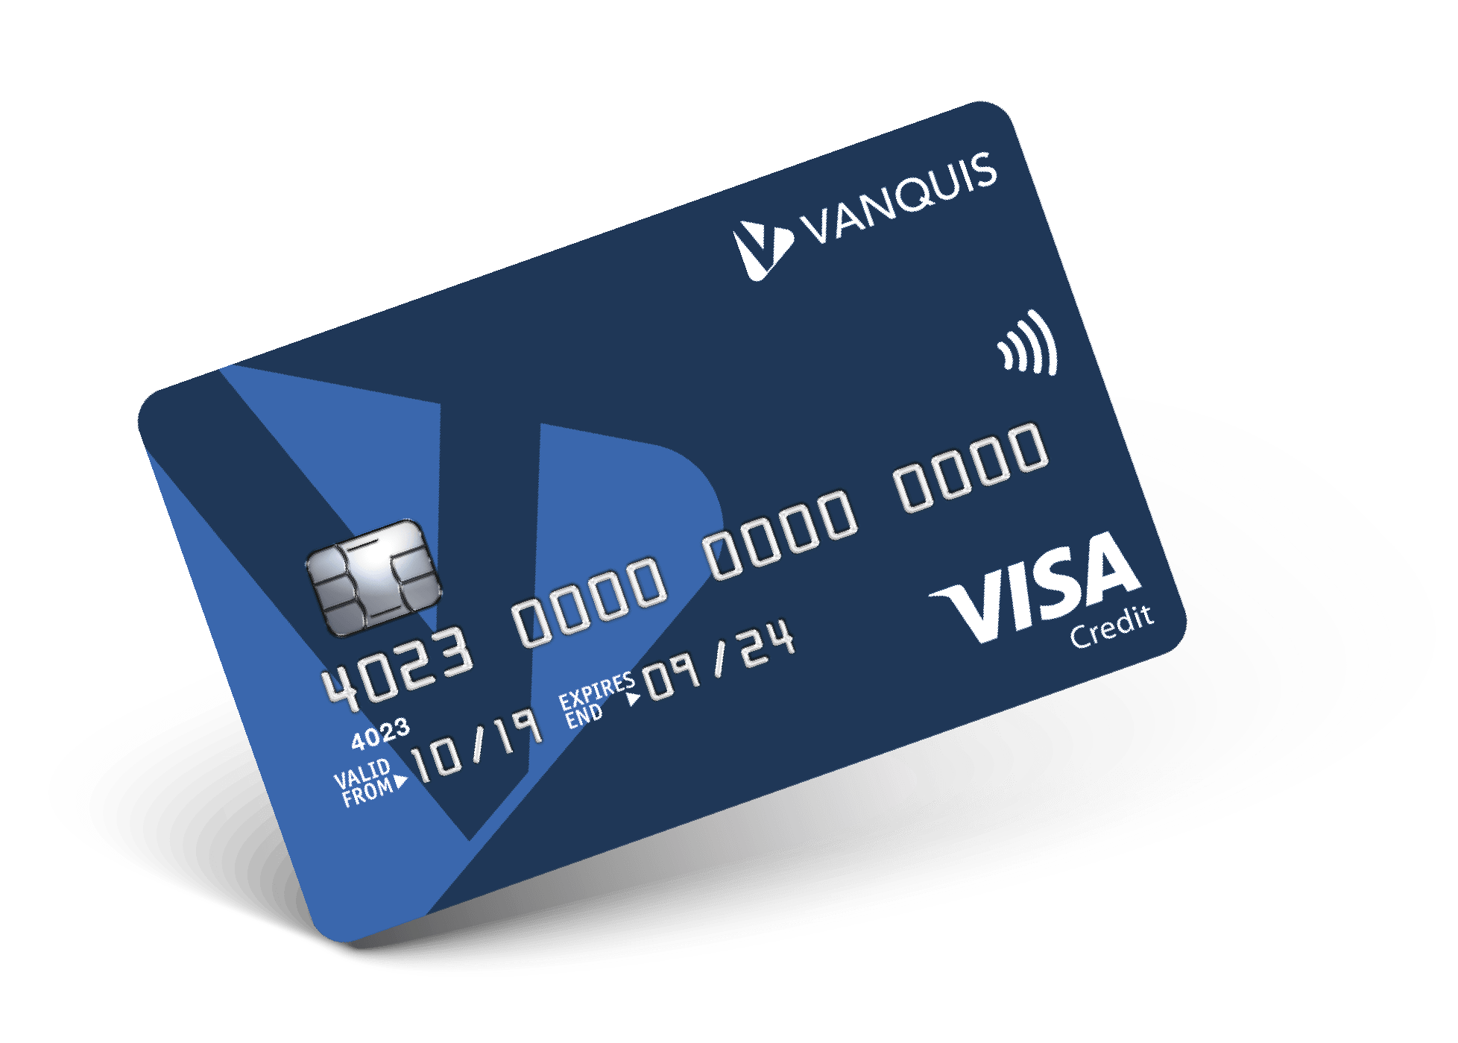
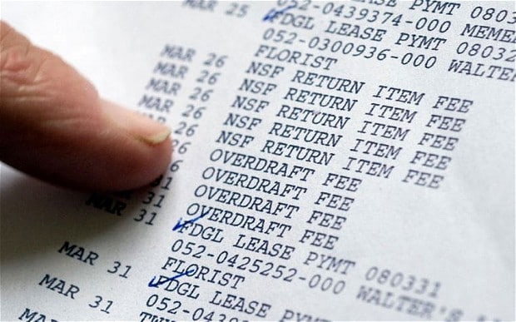


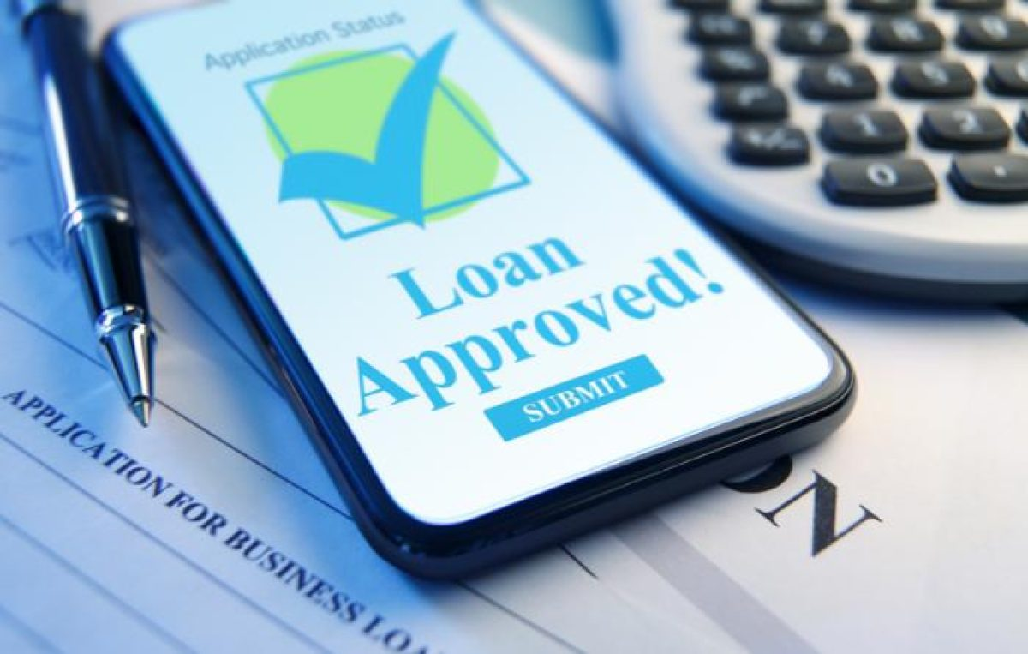
Which debt is good or bad?
Page 4
Credit Card
Student Loan
Payday lender
Overdraft
Personal Loan
Hire Purchase
Klarna
Mortgage
Any terms we do not understand?

Slide 8
Good debt- Usually planned with a clear purpose for investing. It is generally linked to a return on that investment.
Credit Card= short borrowing period
Student Loan = potential better paid job
Payday lender= high interest rates
Overdraft= can come with large fees
Personal Loan= low interest rates
Hire Purchase= car devalues as soon as you drive it. Never get as much as you paid for it
Klarna= unregulated industry so can borrow as much as you want
Mortgage= home ownership

Slide 9
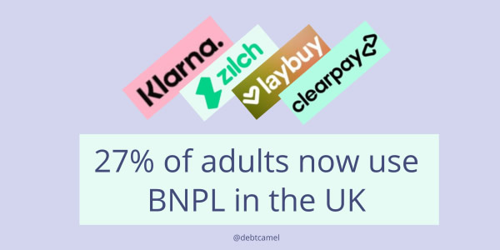
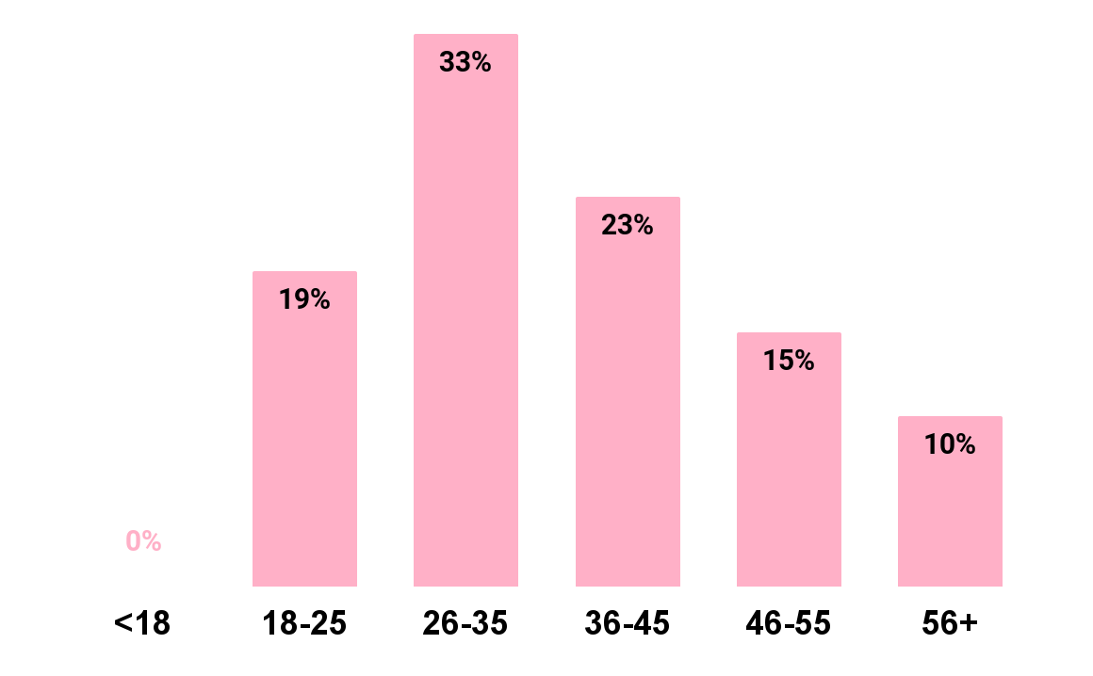
How easy is it to get into debt?
Page 5
Buy now pay later schemes are currently unregulated. This means, that nearly everyone can get access to quick money. This means people who are potentially financially vulnerable can gain access to more debt.
Watch the video and then answer the questions in your booklet.
Buy Now Pay Later The New Debt Crisis 1080 BBC Panorama 13/12/2021 - YouTube

Slide 10
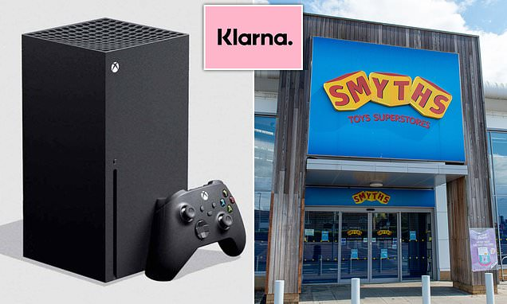
Smyths has just started accepting Klarna (BNPL) for children’s toys. Is this putting extra pressure on parents and potentially putting them in more debt ?

