Slide 1

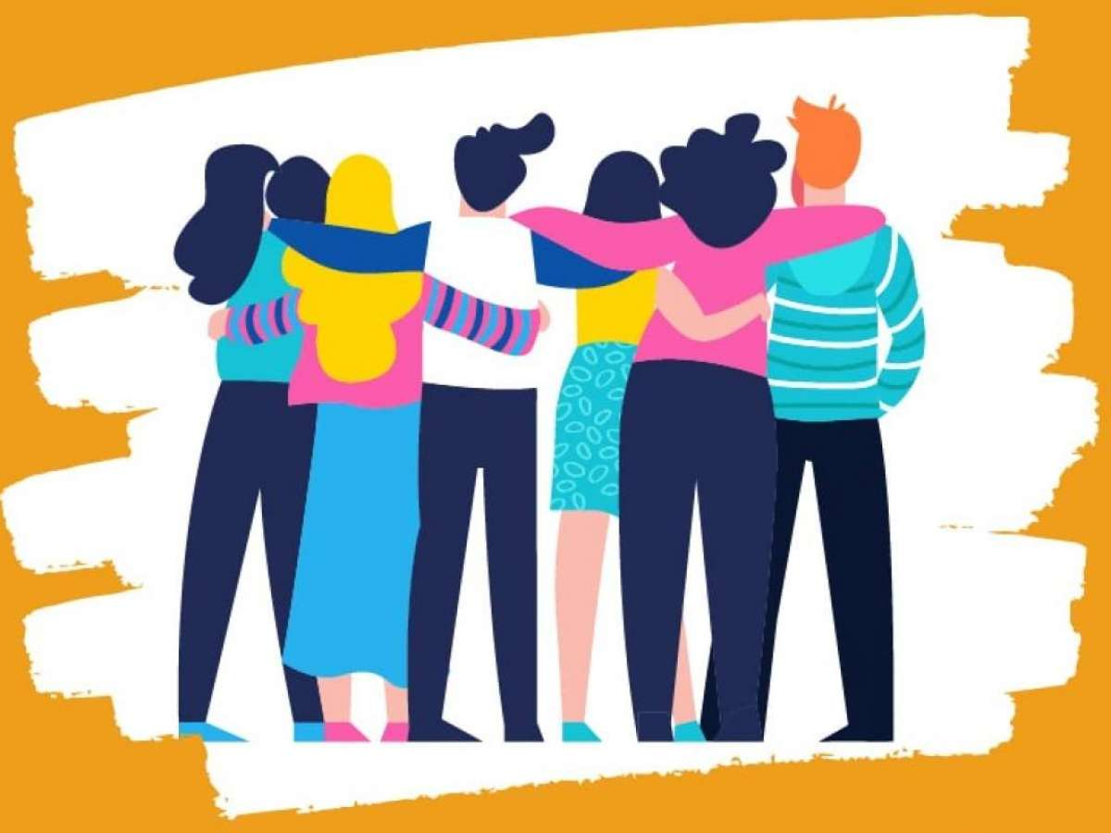
Growth Curriculum- Booklet 1
Year 7 unit 1 2025 – 26
What does a healthy relationship look like?
Orchard Oath Focus:
Be Kind
Name:
Group:
Teacher:
Room:

Slide 2
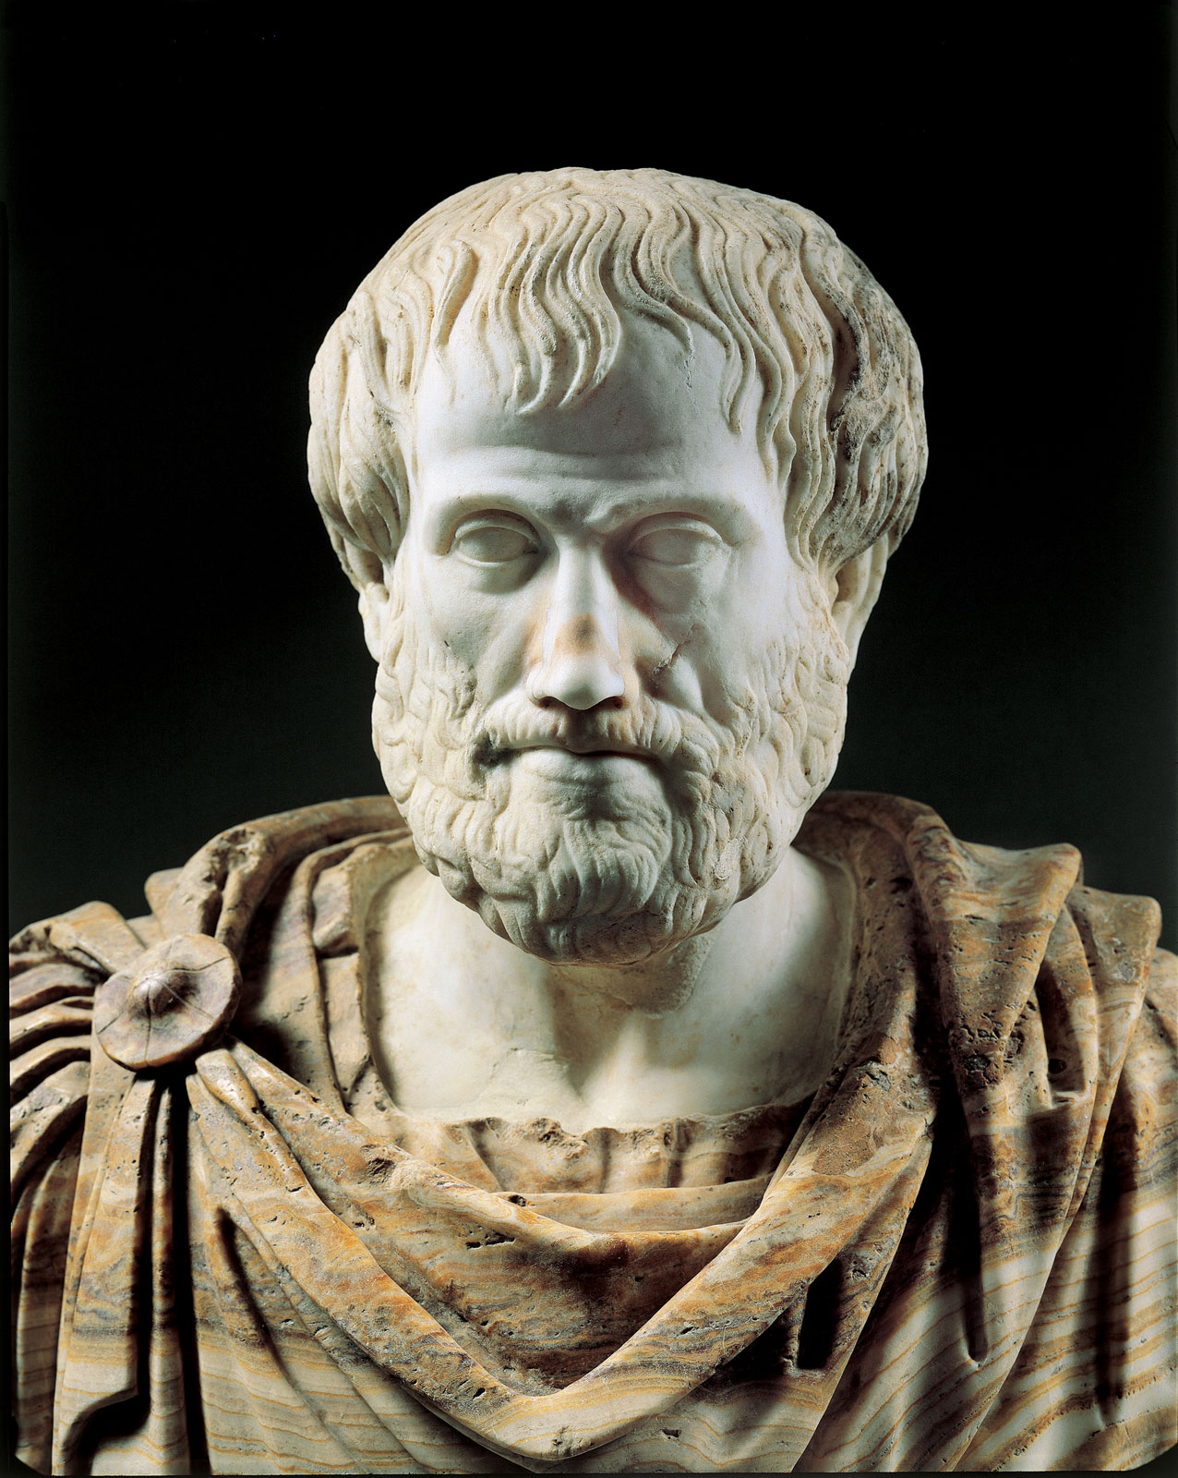
BQ1: What does a good friendship look like?
Friendship
Support
Kindness
Communication
to give encouragement to someone because you want him or her to succeed
being friendly, generous, and considerate
the act of giving, receiving, and sharing information
between two people who like each other
“It is a good thing, he says, to have many friends. No one would choose to live without friends even if he possessed all other goods. there's no friendship among crooks. True friends wish the good of each other. Their friendship lasts as long as they are themselves good and is therefore more enduring.” Aristotle
Highlight the most important part of this quote
2. Pick one of your highlighted sentences and explain how it could be interpreted
I highlighted
This could mean
If Aristotle thought friendship was important thousands of years ago. Name the most important factors in a friendship.

Slide 3
From the video, how can we help people who may be feeling lonely or bullied
Your friend only wants to talk when no one else is around | Your friend always supports you when someone says mean things | Your parents do not like your friend, they say that they can see them ‘changing’ you. | Your friend never disagrees with you.
A good friend has everything in common. | Your friend always covers for you when you want to sneak out without telling your parents | Your friend always says nasty things about you to other people | They always tell you to do things that will get you into trouble
Your friend always asks you to do things that you aren’t comfortable with because its ‘cool’ | Your friend always has your back in any argument. After they will have a conversation about how it could be handled differently | Your friend always wants to play out with older people, even if you feel uncomfortable | Sometimes, when you are around your friend, you just feel lonely and not heard
Reasons why people may fall out of friendship

Slide 4
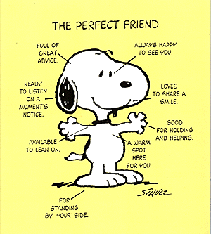
How will I know if I’m in a toxic friendship?
You make excuses for them, and you feel used
This is a sign because
You’re giving more than you’re getting
Giving more in a friendship shows
You dread checking your phone
Feeling uncomfortable about communicating with them means
Do you know any more signs of a toxic friendship?
Challenge- A good friend
Create a guide for younger students on being a good friend. You can include;
Explain what a friend is
Explain why having friends is important
Explain specifically what you will expect from a friend
Describe the qualities a good friend would need (honesty)
A section on what a good friend should NOT do (lie, steal)

Slide 5
BQ2: what types of friendships exist? Why?
What does the term friendship mean?
Name two factors of a positive friendship.
3. What are the signs of a toxic friendship?
Toxic friendship
Loyalty
Empathy
Active listening
listen attentively to a speaker, understand what they're saying, respond and reflect on what's being said, and retain the information for later.
Understanding different perspectives, being kind when others are struggling.
One-sided, unfair treatment of one of the friends, unkind treatment of a friend by another.
a strong feeling of support or being an allie for someone
What can you see in these photographs?
How can you tell that these people are friends?
What are the characteristics of a positive friendship?

Slide 6
What does Xavi think is important in a friendship?
How does Xavi value friendship?
What is Xavi’s advice for making and keeping good friends?
Task 1: why does this change as we get older?
Task 2: why is it often hard for people to make friends as they get older?
I DO: Our eye and hair colour
What are the things that make us who we are?

Slide 7
Scenario 1- Jasmeet
Is it ok to make jokes like this? What do you think?
2. Why do you think Jasmeet is so body conscious?
3. How might this body shaming effect Jasmeet?
Scenario 2: Phoebe
1. Is it ok to say these things? What do you think?
2. Why do you think the students in her class said this?
3. How might this body shaming effect Phoebe?

Slide 8
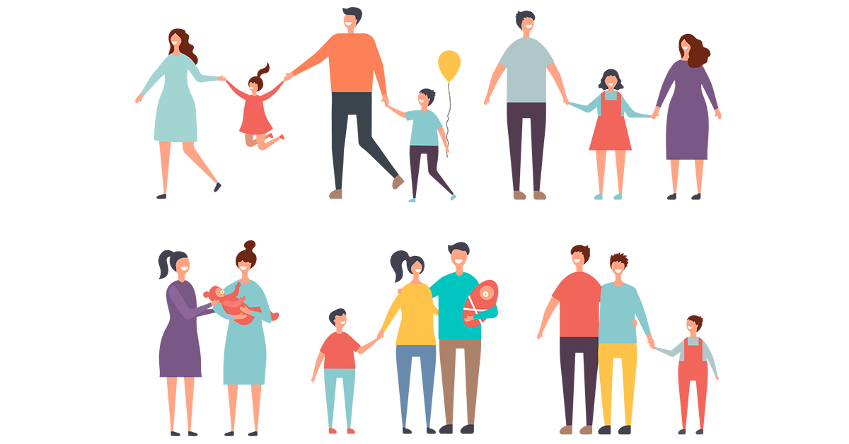
BQ3: What types of families are there?
1. What is a toxic friendship?
2. What are the effects of body shaming?
3. What is an important factor in a friendship?
Lesbian · Gay · Bisexual · Transgender · Transsexual · Queer · Questioning.
a group of one or more parents and their children living together as a unit
a family group consisting of parents and their children (one or more)
feeling of deep affection
Nuclear
Family
LGBT
Love

Slide 9
Religion | Beliefs about family
Explain what the main 6 types of families are, and how these families have changed over the years. (5 marks)

Slide 10
1. Is the Nuclear family always the best family type?
2. Why might nuclear families be decreasing?
What do children of LGBT families find most frustrating?
2. Is it really that different having an LGBT family?

Slide 11
BQ4: Why should children feel safe at home?
a) What are apprenticeships?
b) What is a risk for children walking to school?
c) What is a job you can train for through an apprenticeship?
Exam style question:
a)What is meant by the term free will?
Human rights
Vulnerable
Discrimination
Equality
Exploitation
Able to be easily hurt, influenced or attacked. This could be physical, social, economic or environmental
The state of being equal especially in status, rights or opportunities.
The 30 rights that everyone gets simply because they are human. They should apply to absolutely everyone.
The act of treating someone unfairly in order to benefit from their ‘work’.
Prejudicial treatment or outlook based on protected characteristics

Slide 12
Why do you think people find it difficult to explain what is meant by human rights?
What are human rights? Add examples
What is the name of the worlds most widely accepted documents on humans rights?
Who stands up for the rights of children? How?
Why are Human Rights Important?
List 3 ways human rights are important

Slide 13
Which do you think are the most important? Choose 3 and explain why they are the most important.
PQC: “Children need their rights protecting more than adults do.” Do you agree? Why?

Slide 14

BQ5: What is honour violence?
1. A volcano has just erupted and has killed 10 people on a island, is that an example of moral or natural evil?
2. What is meant by the term sanctity of life?
3. What are human rights?
3. The Nazi regime is a an example of which evil? Explain your reasoning
Honour based violence
Forced marriage
Honour
Shame
A number of violent ways that are used to control the victim.
High respect
a painful emotion caused by having done something wrong or improper.
One or both parties do not consent to the marriage
In the Disney film Mulan. Mulan brings honour to a family by being ‘marriage’ material. In the video, you see the women of the family helping Mulan get ready to meet the ‘match-maker’. The story of Mulan is her fighting her family to live a life that she wants.
The story of honour in Mulan is true for lots of people around the world.
In some parts of the world, honour comes from how the community looks at the family. If the community looks at people within the family negatively, they will not carry respect in the community.
What does Mulan have to do before meeting the match maker?
How will Mulan help bring ‘honour’ to the family?
In the song the lyrics are ‘Men want girls with good taste, Calm, Obedient, Who work fast-paced you'll bring honour to us all’
In the view of Mulan’s community, how should women act?

Slide 15
What is Honour Based Abuse?
HBA is a broad term used to describe a combination of practices used to control and punish the behaviour of a member of a family or social group, in order to protect perceived cultural and religious beliefs in the name of ‘honour’. Although predominantly associated with women and girls, male members of a family can also be victims. Violence and abuse may occur when it is felt that an individual’s behaviour has broken the ‘honour code’, bringing disgrace to their family or social group. Perpetrators will feel that they need to restore their loss of face and standing within their community. There is often an element of approval and social acceptance from other family members and the community.
Honour based abuse can be physical, emotional pr psychological abuse.
What is the aim of honour based abuse?
Does honour based abuse impact all genders?
Why does honour based violence occur?
As in the film Mulan, honour comes from how communities view the family. This may mean people face forced marriage, if the individual doesn’t want to get married the family may feel shame and dishonour because they are unable to ‘control’ their child. In some cases, if the individual doesn’t follow the ‘rules’ and doesn’t get married, they may be killed. This is called honour killings. Honour killings happen in the UK and are largely unreported.
When is the busiest time of the year for charities helping victims of honour violence?
Why was Qandeel Balooch killed?
How did the killing of Qandeel Balooch influence girls of Pakistan?

Slide 16
BQ6: What is domestic violence?
1. Name 2 human rights.
2. What is meant by the term forced marriage?
3. How did Mulan bring dishonour to her family?
Domestic violence
Abuse
Love
Shame
can be defined as a pattern of behaviour in any relationship that is used to gain or maintain power and control over a partner
is an intense, deep affection for another person.
a painful emotion caused by having done something wrong or improper.
when someone causes us harm or distress
Domestic abuse, also called "domestic violence" or "intimate partner violence", can be defined as a pattern of behaviour in any relationship that is used to gain or maintain power and control over a partner.
In your own words, what is domestic violence?
Emotional abuse | physical abuse | Financial abuse
Coercive control | Online abuse | Harassment/stalking

Slide 17
Case study
My brother gets very aggressive when he is drunk, he shouts at us and demands money from my mum.
Today, after the England game, he came home drunk and hit my Mum, so I called the police. Hes been causing trouble for years and I am done with him. I wish he would disappear so me and mum weren’t so scared of him.
When the football was on at home, we had to stay out of the room. If we had to go through to the kitchen we stayed absolutely silence. Of course, if his team lost we would all feel the effects. Mum would feel the brunt of it.
While he is with his friends, he always puts the nice guy persona but the reality was very different.
What type of abuse is happening here?
What else could the child do in this situation?
Why would football make people more violent?
Case study
Your friend always seems to be sad or moody when his Dad comes back home. You’ve known for years that he hasn’t had a good relationship with his Dad because his Dad is always in and out of his life. Your friend always says that his Dad is always angry. Recently, your friend mentioned that ‘Dad’s back’ and you’ve noticed a few weird bruises on his arm.
As a friend, what would you do next?
Domestic violence will affect 1 in 4 women and 1 in 6 men in their lifetime
Do you agree or disagree with this statistic? Explain why
Are males less/more likely to tell someone? Explain your reasoning

Slide 18
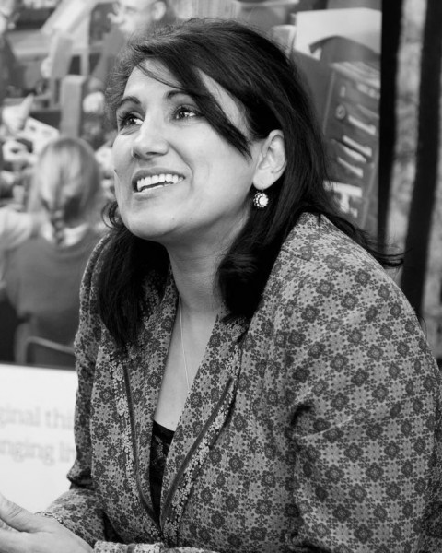


Jasvinder’s story
Note space:
Challenge- Every year on the 14th July, Karma Nirvana hold a day of remembrance for everyone that has lost their life to honour killings or violence.
Create a plan of how we can remember the many people that have lost their life here at Orchard Mead Academy.
As part of the fundraising committee within the school. How can we help raise awareness and fund for the charity Karma Nirvana?

Slide 19

Growth Curriculum
Year 7 Unit 2 2025 – 26
How can I become more responsible when encountering hazards and risks in everyday life?
Orchard Oath Focus:
Be Responsible
Name:
Group:
Teacher:
Room:

Slide 20
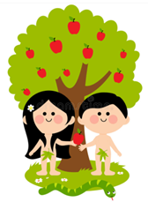

BQ1: Do we really have any control?
Islam
Christianity
Free-will
Predestination
Is the belief that everything that happens has already been determined by God.
Is a religion followed by Muslims around the world.
Making a decision, thinking and then choosing the option we would like to do / have.
A religion followed by Christians around the world and Jesus is the son of god.
Who created Adam?
2. Were Adam and Eve allowed to eat from all trees within the Garden?
3. What was the tree called that Adam and Eve was not allowed to eat from?
_________________________________
#
4. Which animal asked Eve to eat from the tree?
________________________________________________________________________________________________________________5. How is free-will argued in the story of Adam and Eve?
Genesis 3 is called ‘the fall’ why do you think this is?

Slide 21
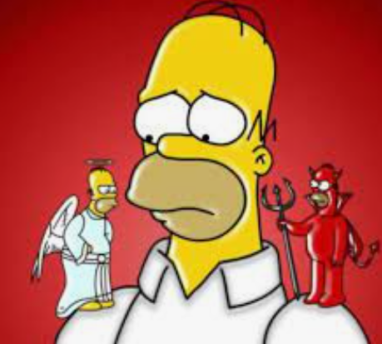
Muslims also believe that angels are with them at all times. They have two angels, which sit on either shoulder and are known as Al-Kiram and Al-Katibun. One of the angels records the good things the person has done and the other records the bad things the person has done. Allah will judge each person based on these deeds, deciding whether they are worth of Paradise (Jannah or Hell (Jahannam).
What is the role of the angels?
How does this link to free will and predestination?
Statement: | True / False | Why
Predestination is the belief that all humans are capable of making choices for themselves
Free will is only a belief held by Muslims
Predestination is demonstrated in the story of Adam and Eve
Beliefs about free will / predestination do not impact on the risks that people take.

Slide 22

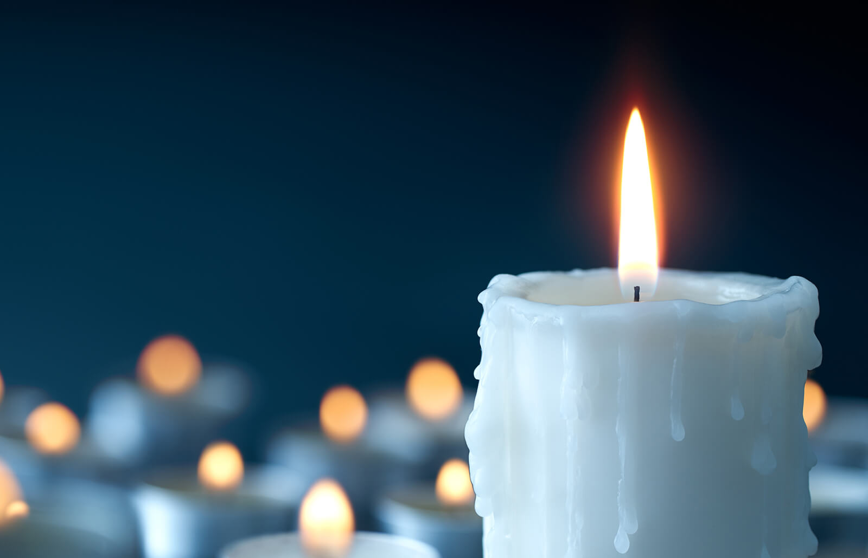
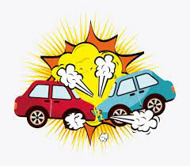
BQ2: How can we keep safe?
Do now: Drill questions:
What is the name of the holy book that Christians read?
B. How many angels sit on a persons shoulder in Islam
C. State two punishments that Adam & Eve received for failing to follow God’s punishment
Exam style question:
What is meant by the term free will (2 marks)
Risk
Perception
Reduce
Hazard
Something can cause harm
Is the chance, high or low, that any hazard will actually cause somebody harm
Make smaller or less in amount, degree or size
The way that we see things that might be different to others
How does each person perceive the risk?
Person 1
Person 2
How will the perception of the risk change?
Person 1
Person 2

Slide 23
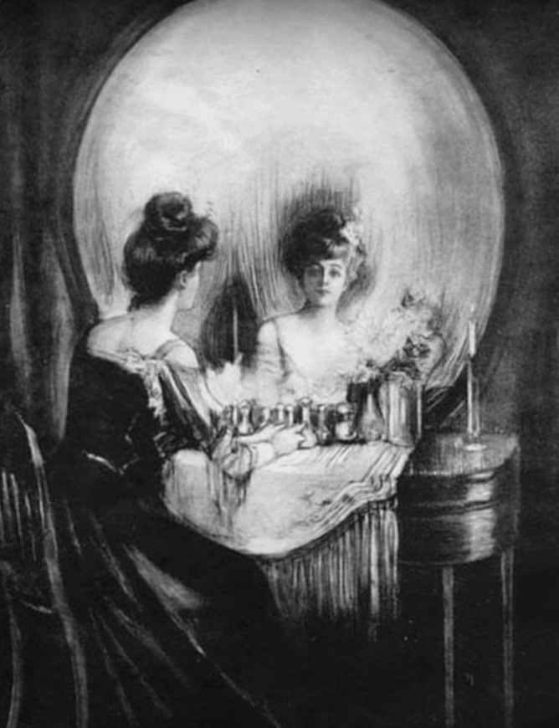
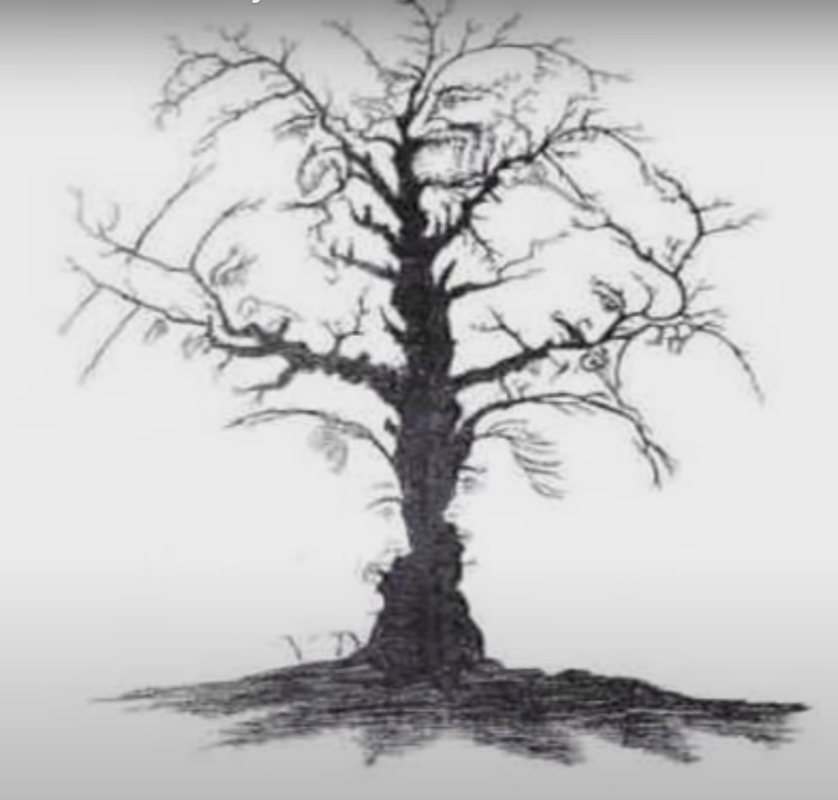
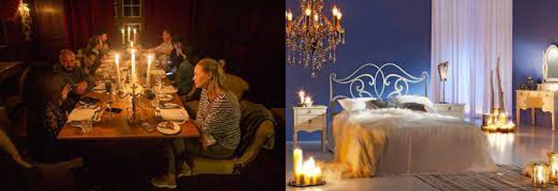
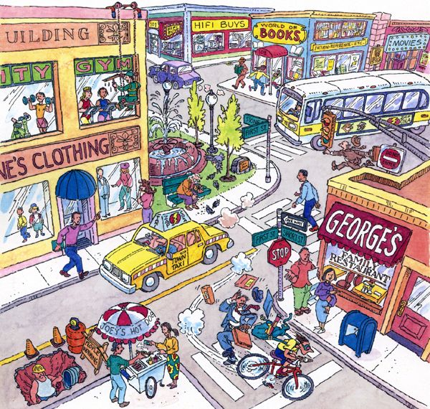
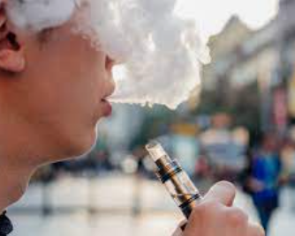
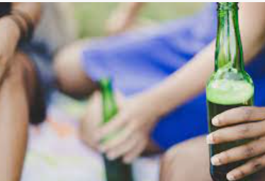
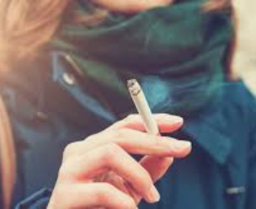
Both rooms carry the same hazard of a candle.
The risk changes as nobody is supervising the candle in the bedroom.
This makes the risk of a fire hazard higher.
Name the hazards
Pick two hazards and explain how you can reduce the risk of the hazard.
What affects a person's perception of these hazards?
5.

Slide 24
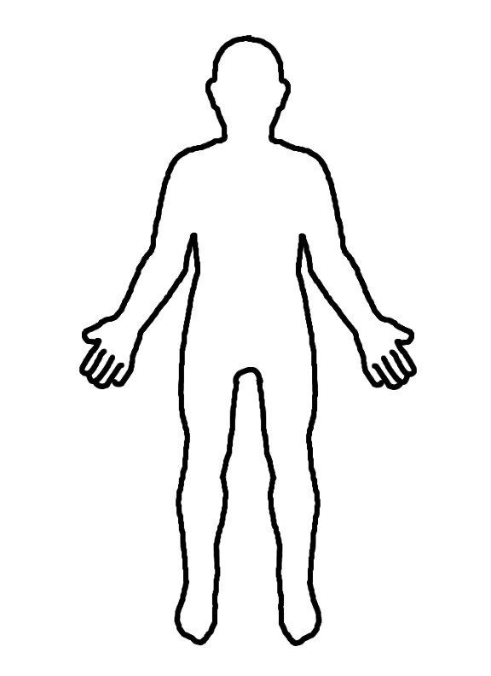
BQ3: Why do some people bully?
Do now: Drill questions:
1. What is the name given to a person who does not believe in God?
2. What is meant by the term hazard?
What is meant by the term pre-destination ?
Friendship
Support
Kindness
Communication
to give encouragement to someone because you want him or her to succeed
being friendly, generous, and considerate
the act of giving, receiving, and sharing information
between two people who like each other

Slide 25
STRESS AND TRAUMA:
Our data shows that those who bully are far more likely than average to have experienced a stressful or traumatic situation in the past 5 years. Examples include their parents/guardians splitting up, the death of a relative or the gaining of a little brother or sister. It makes sense because we all respond to stress in very different ways. Some of us use positive behaviours, such as meditation, exercise and talking therapy – all designed to relieve the stress. Others use negative behaviours such as bullying, violence and alcohol abuse, which temporarily mask the issues but usually make them worse in the long-term. AGGRESSIVE BEHAVIOURS:
66% of the people who had admitted to bullying somebody else were male. Take a minute to think about how guys are raised in our culture and compare that to the ways in which girls are raised. The moment a guy starts to show any sign of emotion, he’s told to man up and to stop being a girl.
For girls, it’s encouraged that they speak up about issues that affect them.
For guys, it’s discouraged and so they start to respond with aggressive behaviours, such as bullying, as a way of coping with issues that affect them. This is why guys are more likely than girls to physically attack somebody or to commit crimes. It isn’t something they are born with, it’s a learned behaviour that is actively taught by society using dysfunctional gender norms and roles.
LOW SELF-ESTEEM:
In order to mask how they actually feel about themselves, some people who bully focus attention on someone else. They try to avoid any negative attention directed at them by deflecting. But know they might look in the mirror at home and hate the way they look. There is so much pressure to live up to beauty and fitness standards that we are taught to compare ourselves to others, instead of embracing our own beauty.
THEY’VE BEEN BULLIED THEMSELVES:
Our research shows that those who have experienced bullying are twice as likely to go on and bully others. Maybe they were bullied as kids in the past, or maybe they are being bullied now. Often it’s used as a defence mechanism and people tend to believe that by bullying others, they will become immune to being bullied themselves. In fact, it just becomes a vicious cycle of negative behaviours.
DIFFICULT HOME LIFE:
1 in 3 of those who bully people daily told us that they feel like their parents/guardians don’t have enough time to spend with them. They are more likely to come from larger families and are more likely to live with people other than their biological parents. There are often feelings of rejection from the very people who should love them unconditionally. They are also much more likely to come from violent households with lots of arguments and hostility.
LOW ACCESS TO EDUCATION:
Without access to education, hate-based conversation directed at others may be the norm. They may not understand what hate speech is and why speaking about people in a derogatory way is not appropriate.
RELATIONSHIPS:
Finally, those who bully are more likely to feel like their friendships and family relationships aren’t very secure. In order to keep friendships, they might be pressured by their peers to behave in a certain way.
They are more likely to feel like those who are closest to them make them do things that they don’t feel comfortable doing and aren’t very supportive or loving.

Slide 26
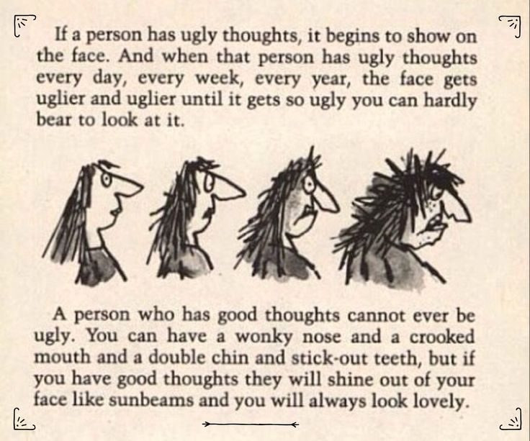
Do bullies bully other people to make themselves feel better? Explain your reasoning
How did the bullies impact Scarlett’s life?
How did Scarlett respond to her bullies in the supermarket?
Who came out of the situation better Scarlett or her bully?
What does Roald Dahl mean by this quote?

Slide 27
BQ4: What is an online troll?
Do now: Drill questions:
1. What is meant by the term risk?
What is the name of the holy book that Christians read?
B. How many angels sit on a person’s shoulder in Islam
Trolls
Online
Abuse
Bully
Treat with cruelty or violence
a person who habitually seeks to harm or intimidate those whom they perceive as vulnerable
A person who posts nasty comments online to intentionally hurt another
Connected to a computer
An internet troll, or online bully, deliberately tries to offend, cause trouble or directly attack people by posting derogatory comments on Facebook posts, blogs, under YouTube videos, on forums and other social media, such as Twitter and Instagram.
An account that looks fake keeps leaving hurtful comments under your friends Instagram posts
Your friend has made a fake Tik Tok account to create a video taking the mickey out of your other friend
You hear a friend say that he always leaves nasty comments on a youtubers videos because he hates him.
Your aHoY has called you into their office because a fake account pretending to be you has left racist and homophobic comments in a person in your year groups comments

Slide 28
‘Living my dream but hating it’
Separately to the documentary, Jesy spoke to BBC Three about the experience of making it.
Thinking back to when she was in the depths of depression while also dealing with her newfound fame with Little Mix, she says: “It was such a weird feeling to be living your dream but hating it at the same time.”
This led her to try to hide her unhappiness.
“I didn’t want to annoy anyone or be seen as a diva,” she explains. “That’s how I thought it would be perceived if I was getting upset. So I thought, 'OK, I'm just gonna ignore this'. It was the worst thing I could have done.”
The trolls only got more vicious if she showed any signs of being upset, she says. "It was like the more people knew it affected me the more they wanted to do it."
But eight years on from when the bullying began, she's feeling much stronger, and has changed her mindset about the people behind the insults.
"Back then I just thought everyone hated me," she remembers. "But no, actually, they're doing it because they feel bad about themselves. So now when I look at trolls being nasty, I feel a bit sorry for them. The only way I can understand it is that being nasty makes them feel better in themselves. I didn't have the mindset to think like that back then – I wish I did.“
She admits the comments made it hard to fulfil her commitments as a member of Little Mix.
"I would leave halfway through a photoshoot, because I couldn't bear looking at myself or being in front of a camera. I used to feel disgusted in myself," she reveals.
"And if the stylist hadn't got the right size for me – by accident – I used to go into a meltdown and think, 'It's not just because I've got the wrong size clothes, it's because I'm too fat to be in them'."
Jesy has now stopped using Twitter, and says she's "a lot mentally stronger and happier".
She says her motivations for making the programme were to try to help others.
“I’m a completely different person now, I’m a lot happier and mentally stronger,” she says. “I really wanted to make this because, as much as it was a horrible experience for me, I want to make something good come out of it. I’ve got this huge platform – why would I not use that to raise awareness of how social media is affecting people?”
How did the comments make Jesy feel?

Slide 29
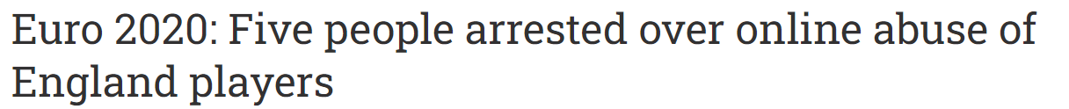
Racist online trolls who abuse footballers now face a ten-year match ban
Priti Patel pressing ahead in the wake of abuse aimed at black England players
Government sources said the new law was expected to be in place in the spring
PM first proposed the plan to extend Football Banning Orders (FBOs) last July
Racist online trolls and people committing other football-related abuse face a match ban of up to ten years.
They will be barred from attending matches under extended ban orders, which are already available for violent thugs and those convicted of racist or homophobic chanting.
Home Secretary Priti Patel is pressing ahead with the measure in the wake of abuse aimed at black England players after the team lost on penalties in the Euro 2020 final.
Will 5 years prison sentence really stop online trolls from abusing people? (5 marks)
Success criteria: | Mark
I have given my opinion in a full sentence. | 1
I have justified my opinion (because ……) | 1
I have included clear and specific examples (more than 1 point) | 1
I have included key words such as: online trolls, abuse, online and social media | 1 = 1-2 2 = 2-3
Total:

Slide 30

BQ5: What are the online dangers?
Drill questions:
1. What is meant by predestination?
2. What is meant by the term agnostic?
3. What is meant by the term perception?
Exam style question:
What is meant by the term hazard?
[2 marks]
Bully
Online
Manipulation
Grooming
Harmful influence over others
The winning of confidence of a victim
a person who habitually seeks to harm or intimidate those whom they perceive as vulnerable
Connected to a computer
Online dangers

Slide 31
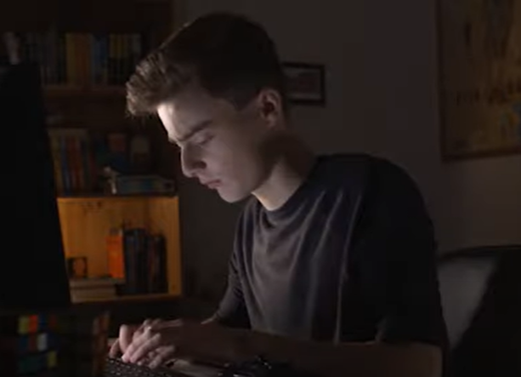
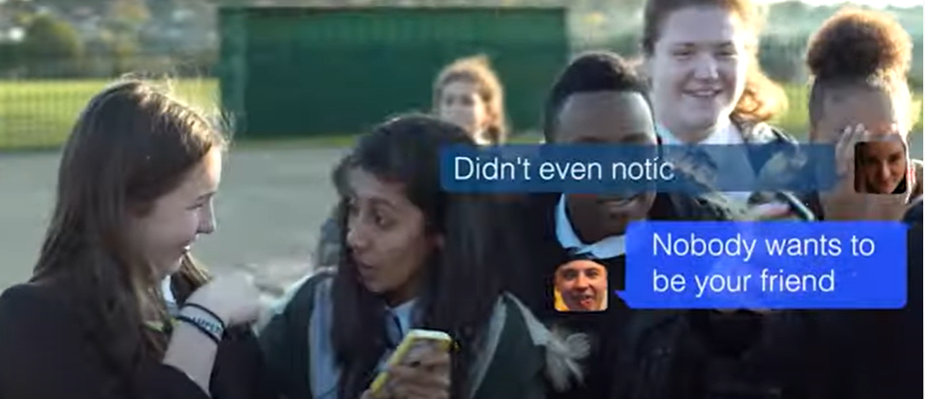
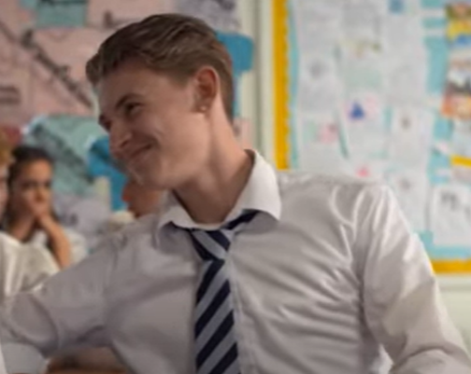
How would Jay feel in this situation?
Did the bystanders help or make it worse?
What would you say if the bully was your ‘friend’?
The term gay was used as an insult.
What are the larger impacts of using the term as an insult at Orchard Mead Academy?
Why is it so important to stand up to bullies and not just giggle along?

Slide 32
 | Concerning? | Why?
Your online friend has asked you to keep information secret from others?
Your online friend keeps asking private questions that make you feel uncomfortable
Your online friend keeps pressuring you to meet up with them
You have a bad gut feeling about them
Brecks last game…
What is grooming in your own words
How was Breck groomed?
Why is it important to listen to your ‘gut feeling’?
Breck was a real person, his Mum pushed for more awareness of online groomers.
What should we be looking out for with online friends?
What advice would you give younger children before they play online games?

Slide 33
BQ5b: How can we stay safe on social media?
1. Why might someone bully another person?
2. What is meant by the term media?
3. What is meant by the term online troll?
Social media
Online
Abuse
Conviction
Treat with cruelty or violence
A judge or jury have found someone guilty of a crime
online platforms and websites that allow users to create, share, and interact with content, as well as connect with others in virtual communities.
Connected to a computer / internet
True or false?
You can use social media at any age
Phones are banned in school
Social media has no negative impact on a child
It is safe to talk to people online
It is safe to meet up with someone you have met online

Slide 34
Have you read the terms and conditions of social media sites?
Why do people not read them?
How do they know your age?
Why are these age limits in place?
Does 13 seem too old or too young? Why?

Slide 35
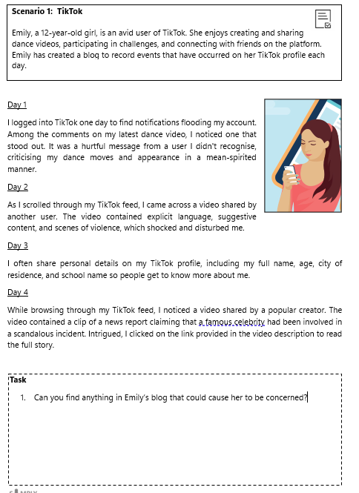

Slide 36
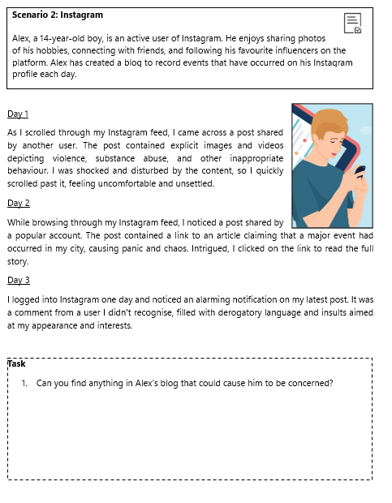

Slide 37
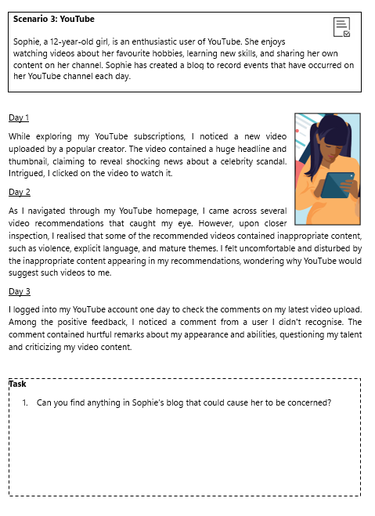

Slide 38
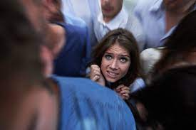
BQ6: Why are boundaries important in relationships?
1. Why might someone bully another person?
2. What is meant by the term communication?
3. What is meant by the term online troll?
4. An individual who you talk to online is asking for your address. Do you share it? Explain your answer
Personal space |  | give permission for something to happen
Boundaries |  | causing or feeling unease
 |  | a line which marks the limits of an area
Consent |  | a line which marks the limits of an area
 |  | the physical space immediately surrounding someone
Uncomfortable |  | the physical space immediately surrounding someone
Physical boundary-
How do we know when people feel uncomfortable when physical boundaries have been ignored?

Slide 39
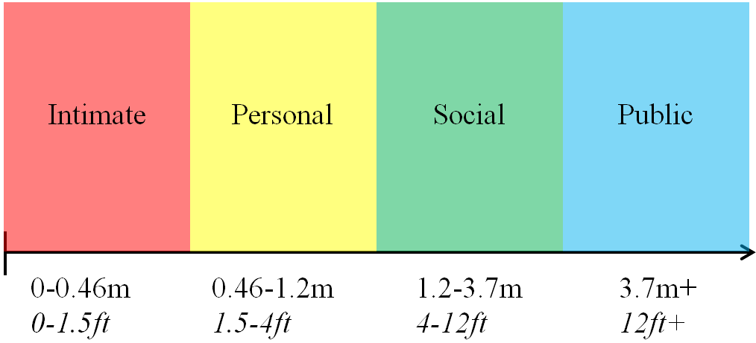
4 zones of personal space
Who is allowed in each space
Public
Social
Personal
Intimate
How does it feel when someone comes into your personal space?
It makes me feel
How do we learn that personal space exists?

Slide 40
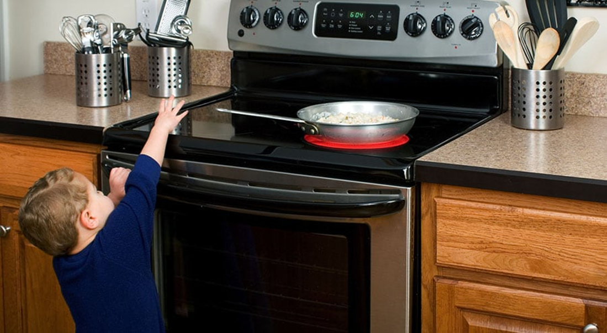
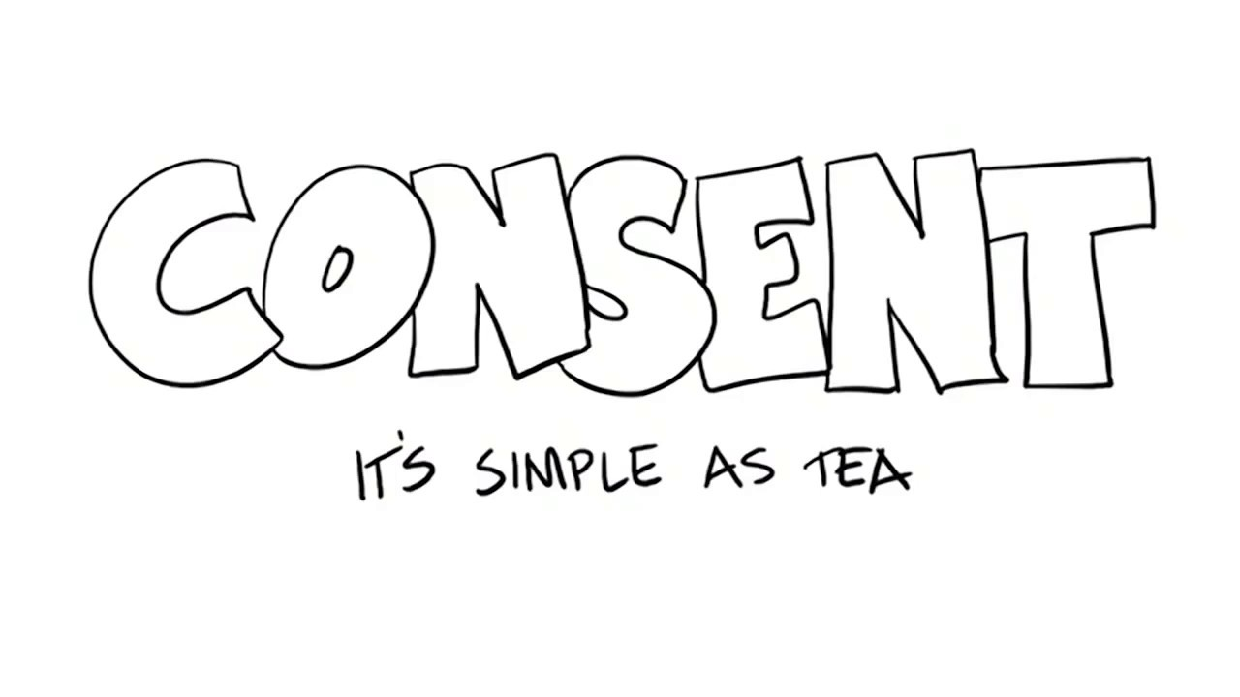
BQ7. What is child on child abuse?
Do now: Drill questions:
Last lesson:
A. What is the hazard in the image?
B. How can we reduce the risk
C. What is the difference between a risk and hazard
Exam style question: What is meant by the term physical boundary?
[2 marks]
What do you think the analogy of tea stands for in the video?
“Consent is an agreement which is given willingly and freely without exploitation, threat or fear, and by a person who has the capacity to give their agreement”
1. Which three words are the most important part of this definition?
2. When have you given consent to someone to do something?
3. As you get older and possibly get intimate with someone why is it important for young people to understand what the definition of consent is?

Slide 41
Types of child-on-child abuse
Ayman is friends with Ali and Ayman knows that Ali is involved with a street gang but Ayman always stays away from that stuff. Ali has started to buy him expensive gifts and tell him that the lads want to meet him.
What type of abuse is happening here?
Molly and Danielle are best friends and Molly has a Saturday job. Danielle always pressures Molly into buying pizza every Saturday for her and the group of friends. Molly doesn’t want to say no because Danielle said that she would start a rumour about her kissing a boy if she refuses.
What type of abuse is happening here?
It’s a windy day and all of the girls skirts are blowing up. Ben decides to take a photo of the row of girls in front and you can see their bums, he sends it to his mates in a group chat for a laugh. They won’t find out.
What type of abuse is happening here?
Ryder and Jack are brothers, Ryder is 16 and Jack is 14. Mum doesn’t like Ryder’s friends and says that their bad news but she cant do anything because she works late at Co-op. Ryder sometimes gets Jack to drop parcels off at his mates house and gives him £20. Jack just wants to stay at home on Fifa with his mates but Ryder said he has to go because he’s his brother.
What type of abuse is happening here?
Neve keeps getting added into a group chat with two other girls in her class, they always say nasty things to her in school but online they keep threatening to kill her. She’s screenshotted the images but doesn’t know how to make it stop.
What type of abuse is happening here?

Slide 42
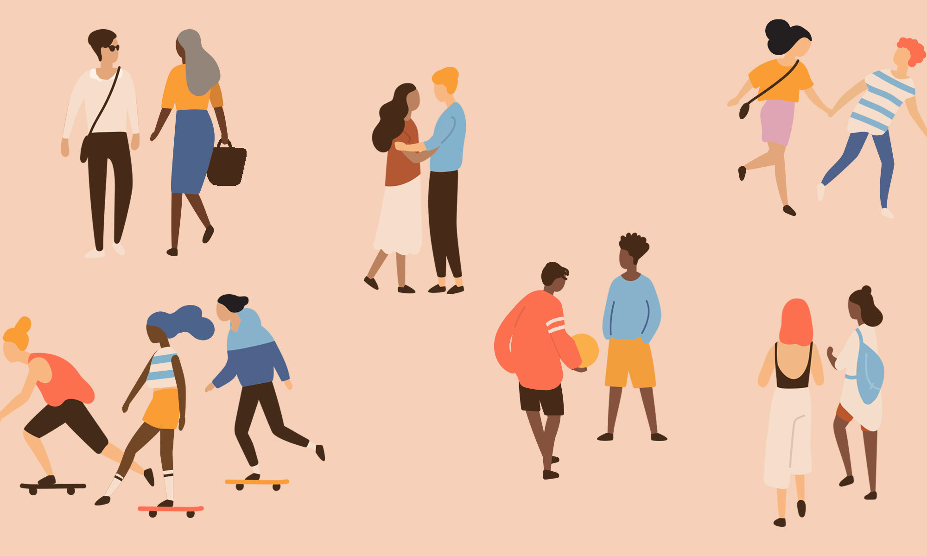
Growth Curriculum
Year 7 Unit 3
All about me! 2025 – 26
Orchard Oath Focus:
Be Kind
Name:
Group:
Teacher:
Room:

Slide 43
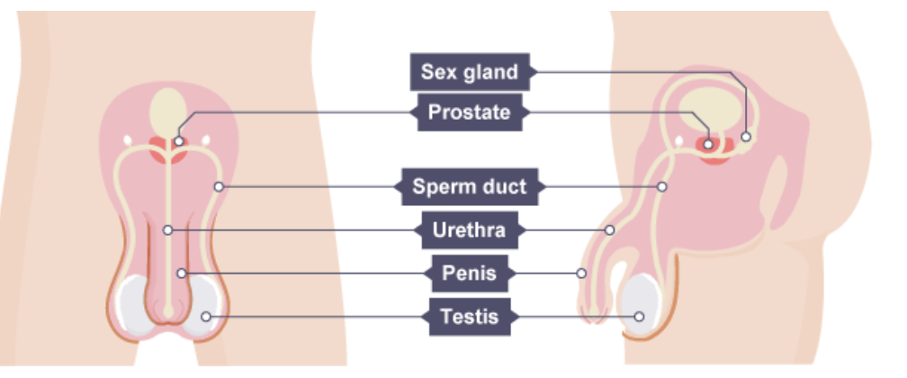
BQ1: What are our reproductive organs?
Do now: Drill questions:
What is the difference between a hazard and a risk?
What is meant by free will?
C. What are the 4 zones of personal space?
progesterone
Oestrogen
Menstruation
Testosterone
produced by the testes – is the main male reproductive hormone and it stimulates sperm production
A hormone released which maintains the lining of the uterus during the latter part of the menstrual cycle and during pregnancy. In men it helps to produce testosterone.
Also called a 'period'. The loss of blood and tissue from the lining of the uterus through the vagina during the menstrual cycle.
Hormone produced by the ovaries, repairs, thickens and maintains the uterus lining
Male reproductive organs
_ _ _ _ _ _ _ _
_ _ _ _ _

Slide 44
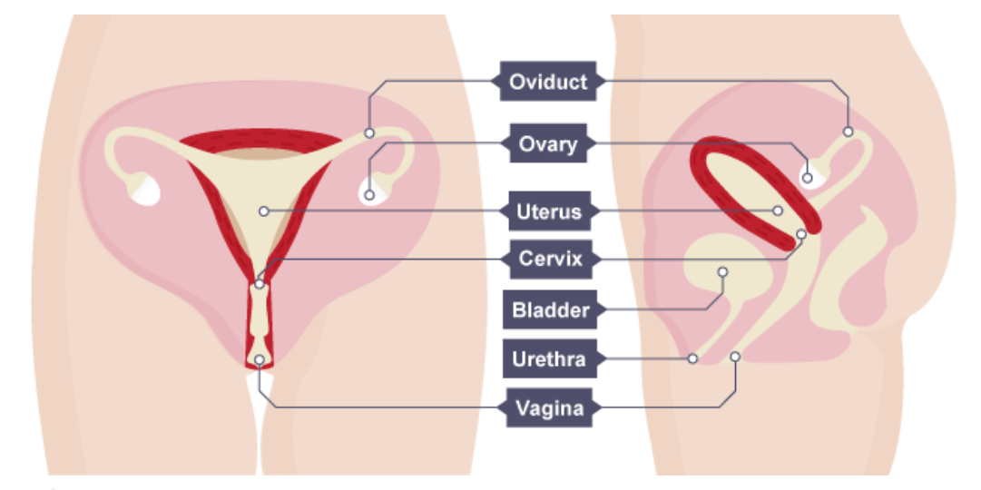
Testes
The _ _ _ testes (one is called a
testis) are contained in a bag of
skin called the _ _ _ _ _ _ _ . They
have two functions:
to produce _ _ _ _ _ (the male gametes or sex cells)
to make the hormone
_ _ _ _ _ _ _ _ _ _ _ _.
Sperm duct and glands
The _ _ _ _ _ pass through the
sperm ducts, and mix with fluids
produced by _ _ _ _ _ _ (seminal
vesicles). The fluids provide the
sperm _ _ _ _ _ with nutrients. This
mixture is called _ _ _ _ _ .
Scrotum | Sperm | Glands | cells | Penis | Urine
Sperm | sperm | Sexual | Muscle | tube | Urine
sperm | two | Semen | testosterone
Penis and urethra
The _ _ _ _ _ has two functions:
to pass _ _ _ _ _ out of the body from the bladder
to pass _ _ _ _ _ into the vagina of a woman during _ _ _ _ _ _ intercourse
The urethra is the _ _ _ _ inside the penis that can carry _ _ _ _ _ or
semen. A ring of _ _ _ _ _ _ ensures that urine and _ _ _ _ _ do not get
mixed up.
B. Female reproductive organs
Ovaries
The two ovaries contain _ _ _ (eggs).
Ova are the _ _ _ _ _ _ gametes or
sex cells. _ _ _ _ _ have these cells in
their bodies from _ _ _ _ _, whereas
men produce new _ _ _ _ _ continually.
Oviducts
Each _ _ _ _ _ is connected to the _ _ _ _ _ _ by an oviduct (fallopian _ _ _ _ ).
The oviduct is lined with ciliated _ _ _ _ _. Every _ _ _ _ _ , an ovum (egg)
develops and becomes _ _ _ _ _ _, and is released from an ovary. The cilia waft the ovum along inside the oviduct and into the _ _ _ _ _ _.
Uterus and cervix
The uterus is a muscular _ _ _ with a soft lining. It is where a _ _ _ _ develops
until its birth. The cervix is a ring of _ _ _ _ _ _ at the _ _ _ _ _ end of the
uterus. It keeps the _ _ _ _ in place while the woman is pregnant.
The urethra also opens into the
_ _ _ _ _, but it is separate from
the _ _ _ _ _ _. It passes _ _ _ _ _ out
of the body from the bladder.
Vagina
The vagina is a muscular _ _ _ _ that leads
from the _ _ _ _ _ _ to the outside of the
woman's body. A man’s _ _ _ _ _ goes into
the woman’s _ _ _ _ _ _ during sexual intercourse. The opening to the vagina has folds of _ _ _ _ called labia that meet to form a vulva.

Slide 45
About how long does a menstrual cycle take?
a. About 28 days
b. About 14 days
c. About 5 days
2. What is ovulation?
a. The loss of the lining of the uterus
b. The joining of male sex cell and female sex cell.
c. The release of the maturing egg cell.
3. In what stage of life do periods
stop?
a. Puberty
b. Menopause
c. Menstruation
d. Ovulation
4. What happens to progesterone levels
during pregnancy?
a. No change
b. stay high
c. Increase
d. Stop entirely
5. On which day of the menstrual cycle
does menstruation start?
a. Day 28
b. Day 5
c. Day 1
d. Day 14
6. Where are ova usually fertilised?
a. ovaries
b. Vagina
c. Oviducts
d. Uterus
BQ2: What is puberty?
Do now: Drill questions:
What is a hazard? _____________________________________________
____________________________________________________________
2. What is a risk? _______________________________________________
____________________________________________________________
Name 2 reproductive organs for biological females. ____________________
____________________________________________________________
What happens to progesterone levels during pregnancy? ____________________________________________________________________________
What is meant by the term menstruation [2 marks] ________________
_____________________________ ______________________________________________
Puberty
Testosterone
Oestrogen
Secondary sexual characteristics
Produced in by the ovaries – controls the development of female secondary characteristics.
Body features, other than reproductive organs that appear during puberty and different in males and females e.g. breasts & beards
The time of life when a child experiences physical and hormonal changes that mark a transition into adulthood.
Produced by the testes, controls the development of the male sexual characteristics

Slide 46
Males
Females
Both
Pubic hair grows | Voice deepens gradually | Voice breaks | Pubic hair: face & body
Hips get wider | Breasts develop | Underarm hair grows | Sex organs grow
Body becomes muscular | Testes start to produce sperm cells | Ovaries start to release egg cells.
Notes / questions about the video:
_____________________________________________________________________________________________________________________________________________________________________________________________________________________________________________________________________________________________________________________________________________________________________________________________________________________________________________________________________________________________________________________________________________________________________________________________________________________________

Slide 47
BQ3: Why should I keep up to date with my jabs ?
Do now: Drill questions:
How could a teacher be affected if a pupil is hurt in a road traffic accident? ___________________________________________ ________________________________________________________
c. What is a fallopian tube? _______________________________________ _____________________________________________________________
d. What meant by consent? __________________________________________________ _____________________________________________________________
Protection
Human papillomavirus
Vaccine
Cancer
is a type of medicine that trains the body's immune system so that it can fight a disease
is when abnormal cells multiply and grow out of control.
Human papillomavirus is a very common group of viruses. Some types can cause genital warts or cancer.
keeping something or someone safe
How do vaccines work?
Vaccines can train your body to sicknesses before they even start. They do this by introducing something called an antigen (usually by a needle) into the body, which imitates an and primes the immune system to respond. That way, if you encounter certain disease-carrying organisms, known as pathogens, in the future, your already has a plan of attack.
Vaccines teach your immune system how to create antibodies that protect you from diseases. It's much safer for your immune system to learn this through than by catching the diseases and treating them. Once your immune system knows how to fight a , it can often give you life long protection.
Prevent | vaccination | body | Disease | Infection

Slide 48
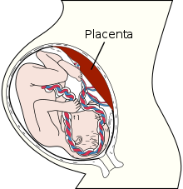
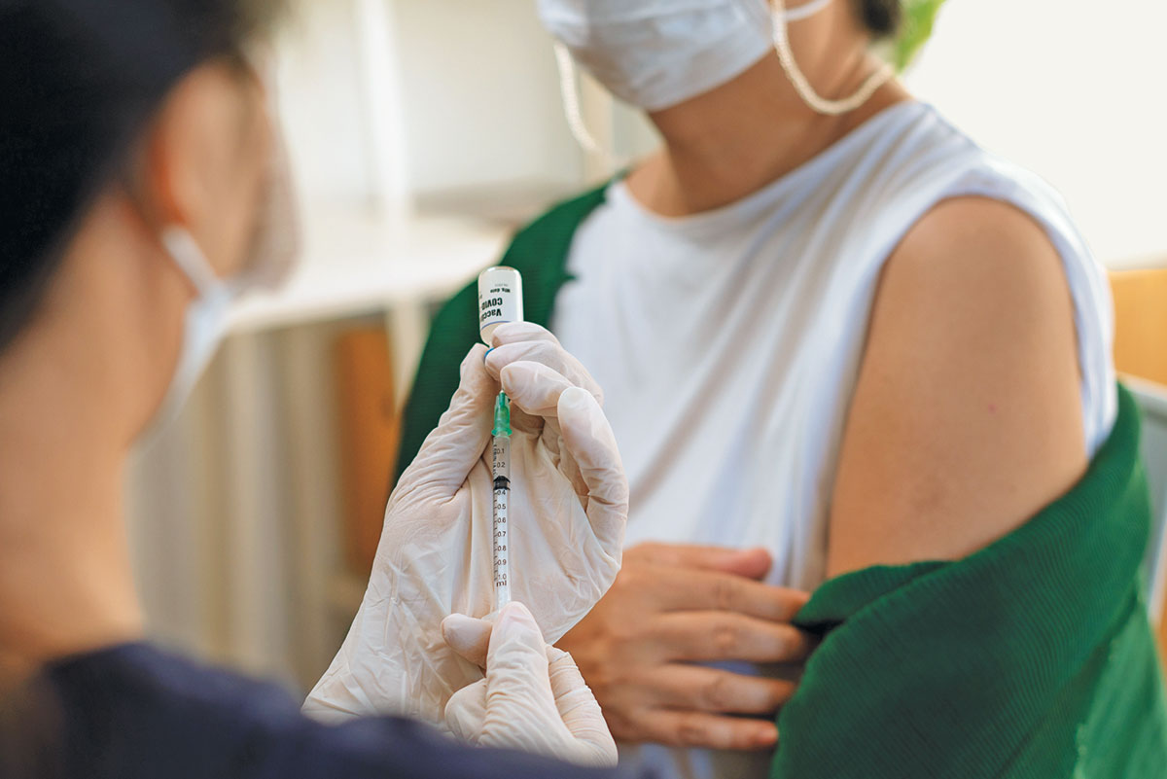
Natural immunity is
Acquired immunity is
Is the HPV vaccine offered to all sexes?
What year group is it offered?
What does it protect young people from?
How many doses are required?
Should more young people be made aware of the vaccine that’s on offer?
In 2025 the NHS changed the routine cervical screening from 3 to 5 years- Is this a good or bad thing in your opinion?
Measles outbreak (MMR) jab
UK health services are battling an outbreak of measles — causing alarm in a nation that had eliminated the disease in 2017.
On 19 January, the UK Health Security Agency (UKHSA), the public-health authority, declared a national incident over rising cases of measles. The agency has logged more than 300 cases in England since 1 October 2023 (see ‘Measles surge’).

Slide 49
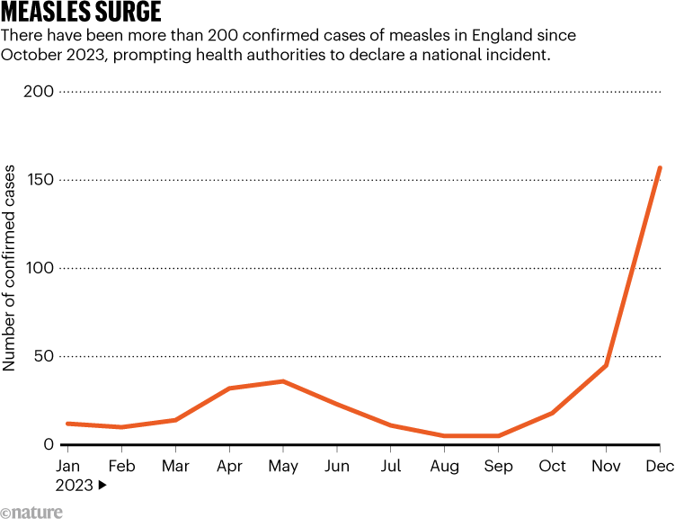
A decline in uptake of the measles, mumps and rubella (MMR) vaccine, which is given in two doses, during the COVID-19 pandemic has spurred the spread of the disease across England and the rest of Europe, while small outbreaks have occurred in a handful of US states.
Measles is caused by a virus and is highly contagious. It is spread through coughing and sneezing. Symptoms include a fever, a runny nose and an itchy rash of red-brown spots. “It’s considered to be one of the most infectious respiratory infections there is,” says population-health researcher Helen Bedford at University College London. Those most at risk include babies, young children, pregnant people and those with a weakened immune system.
Why are measles cases rising in the United Kingdom?
Low uptake of the measles vaccine is a key driver of the UK measles cases, say researchers. Around 85% of children in England have received two MMR vaccine doses by five years old, according to data from the National Health Service (NHS). This falls below the vaccination rate of at least 95% needed to achieve ‘herd immunity’ — which substantially reduces disease spread — as recommended by the World Health Organization (WHO; see ‘Jabs needed’).
Should people receive vaccinations to protect other people too?

Slide 50
BQ4: What is FGM?
Do now: Drill questions:
What is a hazard?
Name 2 female reproductive organs.
C. State two ways your body changes during puberty.
Exam style question:
What is meant by the term free will (2 marks)
Female genital mutilation (FGM)
External Genitalia
Abuse
Human rights
The reproductive organs that can be seen on the outside of the body
Treat with cruelty or violence
All procedures involving partial or total removal of the external female genitalia
The rights that everyone has simply because they are human.
Why does FGM occur?
The most frequently cited reasons for carrying out FGM are social acceptance, religion, misconceptions about hygiene, a means of preserving a girl or woman's virginity, making the woman "marriagble" .
In some cultures FGM is regarded as a rite of passage into adulthood, and considered a pre-requisite for marriage.
Although there are no hygienic advantages or health benefits to FGM, practising communities believe that women's vaginas need to be cut - and women who have not undergone FGM are regarded as unhealthy, unclean or unworthy.
Often it's performed against their will, and health professionals worldwide consider it a form of violence against women and a violation of their human rights. When FGM is inflicted on children, it is child abuse.
Why does FGM occur?
How does FGM link to different cultures views on marriage?
What is the view of health professions around the world?

Slide 51
Dangers of FGM?
Letter planning:
Success criteria: [10 marks]
Structure of the letter: | Correct salutations [Dear Minister for Health, yours faithfully [1]
I am writing to you about….. | What is FGM? [1] How many reported cases are there? [1] What does the law say? [1]
This crime is horrific because ……. | What are the life long effects on women [pregnancy, birth, general health] ? [1] Religious / cultural attitudes [1]
I believe that more should be done about this crime and protect young girls. For example, I believe that ….. | What should be done? [1] Is the law enough? [1] What is your opinion of FGM? [1] How should we support victims? [1]

Slide 53
BQ5: Should I bother with my teen vaccines?
Do now: Drill questions:
State 1 risk when you walk to school. ________________________________________________________ ________________________________________________________
State 1 risk when you play online games. ________________________________________________________
Give 2 reasons why it is important to wash regularly during puberty. (2)
Vaccination
HPV
SPF
Risk
The chance that something [hazard] can cause harm.
Sun protection factor, calculated by measuring how much solar energy is required to produce sunburn on protected skin compared to unprotected skin.
Human papillomavirus is a very common group of viruses. Some types can cause cancer.
treatment with a vaccine to produce immunity against a disease
Why do you think that we have a vaccination programme in the UK? _________
____________________________________________________________________________________________________________________________________________________________________________________________________________________________________________________________
______________________________________________________________________________________________________________________________
_______________________________________________________________
2) Why do you think that there is such a difference between the statistics (5 and under vaccines and yr8 & 9?
____________________________________________________________________________________________________________________________________________________________________________________________________________________________________________________________
____________________________________________________________________________________________

Slide 54
What is HPV virus?
______________________________________________________________________________________________________________________________
_______________________________________________________________
2) How do you catch HPV?
______________________________________________________________________________________________________________________________
_______________________________________________________________
3) What does HPV cause in girls?
______________________________________________________________________________________________________________________________
_______________________________________________________________
4) Why is the HPV vaccine needed before you are sexually active?
______________________________________________________________________________________________________________________________
_______________________________________________________________
Moles
Most people have moles and they are usually nothing to worry about until they change in shape, size or colour.
3 signs to look out for if a mole changes
How can we protect ourself from any potential changes?

Slide 55
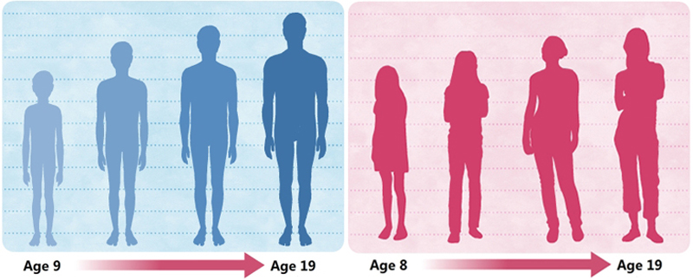
BQ6: How does puberty impact my personal hygiene?
Do now: Drill questions:
1. How does the story of Adam & Eve link to free will?
2. How many angels sit on a persons shoulder in Islam?
a. Name 2 changes that a biological male will experience during
puberty?
  Suggest 2 reasons why puberty is an important part of life? (2 marks) ____
Hygiene
Cleanliness
Odour
Bacteria
Keeping yourself and your surroundings clean
a distinctive smell, especially an unpleasant one.
Bacteria are small organisms, or living things. Once broken down can create a smell
the practice of keeping clean to stay healthy and prevent disease
During puberty young people have an increase in body
due to the increase of hormones in their body. The body produces
more and sweat glands give off different chemicals, some
of these can be stinky. Smells can arise from feet, armpits or .
The best way to lose the smell is to wear clean clothes,
daily and use .
Odour | Genitals | Sweat | Shower | Deodorant
Oil: What can we do about it? ________________
____________________________________
____________________________________
Sweat and odour: What can we do about it? _________________________
___________________________________________________

Slide 56
Which type of deodorant stops sweating?
a. Body spray
b. Anti- perspirant
c. both
d. Neither
2. Why do humans have pubic hair? [min 3 reasons]
____________________________________________________________
____________________________________________________________
____________________________________________________________
3. State 1 misconception regarding pubic hair.
____________________________________________________________
____________________________________________________________
Pick who comes for an interview at Orchard Mead
Group 1-
Group 2-
Group 3-
Why do first impressions count?
_______________________________________________________________
_______________________________________________________________
How does puberty impact my personal hygiene?
_______________________________________________________________
_______________________________________________________________
_______________________________________________________________
_______________________________________________________________
__________________________________________________________
Dr Smith | Miss Arnold | Mrs Fletcher
Mr Green | Mr Phillips | Dr Barnett
Mr Butler | Miss Burton | Mrs Bhayat

Slide 57
BQ7: Why do I need to go to the dentist?
Do now: Drill questions:
What is consent? ___________________________________________ ________________________________________________________
c. What is a fallopian tube? _______________________________________ _____________________________________________________________
d. What FGM? __________________________________________________ _____________________________________________________________
e. Is FGM a religious practice? Yes / no
Tooth decay
Fluoride
Cosmetic dentistry
Dentist
Techniques to improve the appearance of teeth. This can include veneers, teeth whitening and dental implants.
Decay of the outer surface of a tooth as a result of a bacterial infection
A person who is qualified to treat diseases and other conditions that affect the teeth and gums, especially repair and removal of teeth
A naturally occurring mineral commonly used in dentistry to strengthen enamel, which is the outer layer of your teeth. Fluoride helps to prevent cavities.
Which description shows the best steps in caring for teeth each day?
A. Clean between teeth, brush with fluoride toothpaste, rinse with mouthwash
B. Brush with fluoride toothpaste, clean between teeth, rinse with mouthwash
C. Brush with fluoride toothpaste, clean between teeth, spit out excess
toothpaste
D. Clean between teeth, brush with fluoride toothpaste, spit out excess
toothpaste
2. What makes a good toothpaste?
A. Recognisable brand name
B. The right amount of fluoride
C. Higher cost
D. All of the above
3. If someone has severe dental pain and their dentist is closed for the night they
should…
  Take some pain killers and wait until it opens the next day
  Call their dentist and check if there is an out of hours services
C. Call NHS 111
D. Any of the above
4. Which food or drink from the options below is the most damaging to teeth?
  Whole fruit
  Fruit juice
  Smoothie
  Milk

Slide 58
5. Which of the following treatments could be necessary for someone’s dental health?
  Braces
  Veneers
  Tooth whitening
  All of the above
6. Which of the following people is qualified to provide tooth whitening services
A. Dental nurse
B. Dentist
C. Beautician
D. All of the above
7. How can smoking affect dental health?
  Slows healing after teeth have been removed
  Increases risk of gum disease
  Increases risk of tooth loss
  All of the above
Having a dental check-up | Getting veneers (thin pieces of porcelain that cover teeth) | Tooth whitening
Getting braces | Getting a filling to treat tooth decay | Removal of decayed teeth.
Removing wisdom teeth (the teeth at the back of your mouth) | Scale and polish (when a hygienist removes plaque and tartar from teeth) | Root canal (treating a dead tooth nerve)
Remove an existing amalgam (silver) filling with a white filling. | Covering a damaged tooth with a crown.
Sky
Sky visits the dentist regularly and almost always flosses twice a day before brushing their teeth.
After school Sky knocked a tooth out during an accident at rugby practice and they’re pretty sure the dentist is closed! A friend found the tooth and has brought it to them. There hasn’t really been much bleeding but Sky’s mouth feels really sore.
What habits might affect Sky’s dental health?
_________________________________
_________________________________
_________________________________
2. Where might they get support or
treatment? _________________________________
_________________________________
_________________________________
3. What considerations would they need to have when deciding whether to
get treatment? (i.e. cost or risks) ________________________________
___________________________________________________________
___________________________________________________________
____________________________________________________________
____________________________________________________________
________________________________________________________

Slide 59
What habits might affect Jae’s dental health?
______________________________
______________________________
______________________________
______________________________
2. Where might they get support or
treatment?
______________________________
______________________________
______________________________
______________________________
Jae:
Jae drinks lots of cola and coffee and occasionally smokes a cigarette with friends at the weekend. He has developed a stain on his teeth, he’s spoken to his friends about it and they have said that they hadn’t really noticed.
Jae still wants to get rid of the stains. He’s recently bought an electric toothbrush, which has helped a little bit. He hasn’t been to the dentist in a while but he did need some fillings last time he was there
3. What considerations would they need to have when deciding whether to get treatment? (i.e. cost or risks)
_____________________________________________________
_____________________________________________________
_____________________________________________________
_____________________________________________________
Summary:
Write a summary to explain to younger students the importance of regular dental check ups and what they should do in a dental emergency.
_____________________________________________________
_____________________________________________________
_____________________________________________________
_____________________________________________________
_____________________________________________________
_____________________________________________________
_____________________________________________________
_____________________________________________________
_____________________________________________________
_____________________________________________________
_____________________________________________________
_____________________________________________________

Slide 60
BQ8: Why is healthy eating important in society?
DO NOW- Drill questions
1. How many portions of fruit and vegetables are we advised to eat each day?
2. What is the recommended amount of water we should drink each day?
3. What do you think a balanced diet is?
Exam style question: Why is it important to have a balanced diet?
Why do you think Britain currently has a problem with growing obesity cases?
Explain why you think as a nation we struggle to eat healthily and exercise to recommended guidelines, even though we know we should.
___________________________________________________________________________________________________________________________________________________
______________________________________________________________________________________________________________________________________________________________________________________________________________________________________________________________________________________________________
What happened to childhood obesity levels during covid?
Why do you think this happened?

Slide 61
Why did genetics evolve to favour fat storage?
What is the difference between ‘overweight’ and ‘obese’?
How much exercise should a) adults and b) children be getting?
What are some historical factors which have influenced the development of obesity?
Explain some of the problems with using BMI as a means of measurement.
Why do you think adults and children aren’t getting enough exercise?
Explain why disadvantaged communities are harder hit by obesity.
If obesity is a global problem, is there a global solution? If so, what? If not, why? Explain your answer in detail.
__________________________________________________________________________________________________
_________________________________________________
__________________________________________________________________________________________________
___________________________________________________________________________________________________________________________________________________
___________________________________________________________________________________________________________________________________________________
___________________________________________________________________________________________________________________________________________________

Slide 62
Progress Check Question
”The responsibility for the obesity epidemic lies with the government of a country.”
Do you agree or disagree? Maybe you can see both sides of this argument.
Refer to the information from this lesson, and your own views.
______________________________________________________________________
______________________________________________________________________________________________________________________________________________________________________________________________________________________________________________________________________________________________________________________________________________________________________________________________________________________________________________________________________________________________________________________________________________________________________________________________________________________________________________________________________________________________________________

