Slide 1


Growth Curriculum
Year 9 Unit 5
Careers:
How do I choose my GCSE options?
Orchard Oath Focus:
Work hard
Name:
Group:
Teacher:
Room:

Slide 2
BQ1 and 2: what is the Options process?
Do now: Drill questions:
What is meant by peer pressure?
What drug classification is Heroin?
What is meant by grooming?
Exam style question:
What is meant by the term original sin? – refer to the religion it is connected to. [2 marks]
____________________________________________________________________________________________________________________
____________________________________________________________________________________________________________________
____________________________________________________________________________________________________________________
______________________________________________________________________________________________________________________________________________________________________________
Options
GCSEs
Careers
Choices
an occupation undertaken for a significant period of a person's life and with opportunities for progress.
Choosing your GCSE subjects
Alternatives, option, possibility, preference
An academic qualification studied and achieved by sitting exams at the end of year 11.
Important deadlines and events in the process..
18th January 2027 | Options lessons in Growth
^{26th} January 2027 | Options lessons in Growth Taster sessions
1st February 2027 | Option evening 2027
8th February 2027 | Submit option forms
Notes:
By the end of the module, you will have a greater understanding of what to expect over the next few weeks before you make your choices and spent time reflecting on you and the subject you enjoy.

Slide 3
Thinking about the word ‘options’
What words that are related to the word ‘option’?
Choices
Decisions
Selection
Pathways
Possibilities
What do all of these words have in common?
______________________________________________________________________________________________________________________________________________________________________________
This is all about making some very important decisions based on facts information and preferences.
What are option choices?
What did you/your family do before making a big decision?
Notes:
There is an assumption that everyone knows what choosing KS4 Options is all about. Although you may have some awareness or have older siblings who have been through this stage in life, it is worth us being really clear about what this all means. Let’s take the word options firstly – what do we mean – think of some related words, alternative words or synonyms - jot these down in your workbook and then let’s take a moment to discuss them in relation to school.
Choices
Selections
Decisions
Possibilities
Routes
Pathways
Preferences
Alternatives
Favourites
Likes
Judgements
Conclusions
What do all of these words have in common?
This is all about making some very important decisions based on facts information and preferences.

Slide 4
What not to do!
Year 9 Choices - YouTube
Whilst watching the video, write down 3 things you should not do when making your GCSE option choices.
____________________________________________________________________________________________________________________________________________________________________________________________________________________________________________________________________________________________________________________________________________________________
Summarise in less than 10 words why these are important things to consider when making your GCSE options.
Be informed:
Be reflective:
Be patient:
________________________________________________________________________________________________________________________________________________________________________
________________________________________________________________________________________________________________________________________________________________________
________________________________________________________________________________________________________________________________________________________________________
Quiz – Have you been listening?
What do we mean by Post-16?
Give one thing you should NOT do when choosing your options.
When is the deadline for making your option choices?
Name someone you can ask for support or help with your choices.
________________________________________________________________________________________________________________________________________________________________________
________________________________________________________________________________________________________________________________________________________________________
________________________________________________________________________________________________________________________________________________________________________
________________________________________________________________________________________________________________________________________________________________________
Notes:
Don’t make the same mistakes as many other students have done before when choosing their option. Watch the video clip and write down in your booklet what Donna did wrong!
CLICK IMAGE TO GO TO YOUTUBE
NB: video refers to grade A etc. as it is a few year’s old but gets the message across about what to avoid doing wrong when choosing. You could explain what these grades mean in terms of numbers.
Picked a subject to be with friends
Picked subjects because of the teacher
Didn’t read the options booklet so didn’t realise the course content or how assessments worked
Donna did NOT make and informed choice!
Thought she new best!
NB You may want to clarify that coursework is non-examination assessment.

Slide 5
BQ3: what are taster sessions?
DO now:
What drug classification is ecstasy?
Name one example of a holy war
Define the term ‘good’
Exam style question: What is meant by the term evil
____________________________________________________________________________________________________________________
____________________________________________________________________________________________________________________
____________________________________________________________________________________________________________________
______________________________________________________________________________________________________________________________________________________________________________
Options
GCSEs
Careers
Choices
an occupation undertaken for a significant period of a person's life and with opportunities for progress.
Choosing your GCSE subjects
Alternatives, option, possibility, preference
An academic qualification studied and achieved by sitting exams at the end of year 11.
Important deadlines and events in the process..
12th January 2026 | Options lessons in Growth
^{19th} January 2026 | Options lessons in Growth Taster sessions
29th January 2026 | Parents Evening 2026- Options
2nd February 2026 | Hand in of forms opens 2nd February 2026 Hand in forms by 6th February 2026
Notes:
By the end of the module, you will have a greater understanding of what to expect over the next few weeks before you make your choices and spent time reflecting on you and the subject you enjoy.

Slide 6
I want to be a mechanic when I’m older. A course I have researched linked to this career is Motor Vehicle Maintenance and Repair Diploma Level 3 at Leicester College. To gain a place on this course I need to have a GCSE grade 4 in both English and Maths. I also need a grade 4 in two other subjects. I am on the enterprise path to success, so I have also chosen to study business because one day I might go into business for myself.
Why did this student chose their GCSE options?
What questions might they have asked at their taster sessions?
Why / how would taster sessions have helped with their choices?
________________________________________________________________________________________________________________________________________________________________________
________________________________________________________________________________________________________________________________________________________________________
________________________________________________________________________________________________________________________________________________________________________
I’ve always daydreamed about going to university. The courses, the freedom and the social side of university life look so much fun! I’m not sure what I want to study yet, but I know that universities like Oxford and Cambridge like you to do the Ebacc. To help me achieve my goals, I am on the aspire path to success. I have chosen to study French, music, and history.
Why did this student chose their GCSE options?
What questions might they have asked at their taster sessions?
Why / how would taster sessions have helped with their choices?
________________________________________________________________________________________________________________________________________________________________________
________________________________________________________________________________________________________________________________________________________________________
________________________________________________________________________________________________________________________________________________________________________
6

Slide 7
To be completely honest, I was unsure what options to take. I’m not sure what I want to do when I am older so found it difficult to decide. I talked to my older sister who had completed her GCSE at Orchard Mead Academy and she helped me identify which subjects I enjoyed the most. I then went to my teachers in those subjects to ask for more information about the course and my predicted grades in these subjects. Based on these conversations I chose the freedom path to success, picking a wide range of courses that sound like they will suit me the most.
Why did this student chose their GCSE options?
What questions might they have asked at their taster sessions?
Why / how would taster sessions have helped with their choices?
________________________________________________________________________________________________________________________________________________________________________
________________________________________________________________________________________________________________________________________________________________________
________________________________________________________________________________________________________________________________________________________________________
I really like learning about the world around me. I spoke to my form tutor about how I’d like to study humanities subjects at A Level and he helped me choose subjects that will help me get there. I have chosen French as we learn about other cultures, geography as we learn about the world around us, Citizenship to learn about politics and media to learn about how people are presented in the modern media. I like having subjects that link together. I’m going to struggle to pick what else I want to study at college!
Why did this student chose their GCSE options?
What questions might they have asked at their taster sessions?
Why / how would taster sessions have helped with their choices?
________________________________________________________________________________________________________________________________________________________________________
________________________________________________________________________________________________________________________________________________________________________
________________________________________________________________________________________________________________________________________________________________________
7

Slide 8
Write down the taster subject you have done/discussed/looked at textbooks for.
Subject: | What did you learn about the GCSE (key skills needed) | examination
1.Health and social care
2.Citizenship
3.Drama
4.GCSE sport
5.Sports studies
6.Art based subjects
7. GCSE Food
8.GCSE design and technology
10.Music
11. Film studies
12. History
13. Geography
14. Business studies
Notes:
As a teacher of one of the subjects with a taster session, you could model the notes they can take to be most useful to them.

Slide 9
Review
What have you learnt about the link between your taster lessons and options choices?
__________________________________________________________________________________________________________________________________________________________________________________________________________________________________________________________________________________________________
BQ4: what are my options?
Do now: Drill questions:
What is meant by peer pressure?
Who is Andres Brevik?
What is meant by BLM?
Exam style question:
What is meant by the term social justice? [2 marks]
____________________________________________________________________________________________________________________
____________________________________________________________________________________________________________________
____________________________________________________________________________________________________________________
______________________________________________________________________________________________________________________________________________________________________________
Options
GCSEs
Careers
Choices
an occupation undertaken for a significant period of a person's life and with opportunities for progress.
Choosing your GCSE subjects
Alternatives, option, possibility, preference
An academic qualification studied and achieved by sitting exams at the end of year 11.
Important deadlines and events in the process..
18th January 2027 | Options lessons in Growth
^{26th} January 2027 | Options lessons in Growth Taster sessions
1st February 2027 | Option evening 2027
Notes:
Use cold calling to check that pupils have gained some K and U from the task set.
They should have a better understanding of how to judge their taster lessons and what should affect their choice of subject at GCSE by the end of the lesson.

Slide 10
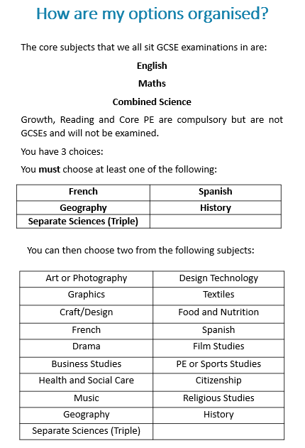
Do now: Should any GCSE’s be compulsory in your view? If so which ones? If not why not?
__________________________________________________________________________________________________________________________________________________________________________________________________________________________________________________________________________________________________
Which GCSE choices can you not do together? Why do you think that is?
__________________________________________________________________________________________________________________________________________________________________________________________________________________________________________________________________________________________________
Making your choices: what do you need to consider?
1.
2.
3.
4.
5.
6.
7.

Slide 11
Subject: | Compulsory/ Optional | Like or dislike after taster sessions Why
1.Health and social care
2.Citizenship
3.Drama
4.GCSE sport
5.Sports studies
6.Art based subjects
7. GCSE Food
8.GCSE design and technology
10.Music
11. Film studies
12. History
13. Geography
14. Business studies

Slide 12
BQ5: what decisions will you make?
Do now: Drill questions:
Last lesson:
What are emotions?
How negative peer influence impact your life?
C. Who may influence us?
D. What is meant by conscience? (2 marks)
Options
GCSEs
Careers
Choices
an occupation undertaken for a significant period of a person's life and with opportunities for progress.
Choosing your GCSE subjects
Alternatives, option, possibility, preference
An academic qualification studied and achieved by sitting exams at the end of year 11.
Important deadlines and events in the process..
18th January 2027 | Options lessons in Growth
^{26th} January 2027 | Options lessons in Growth Taster sessions
1st February 2027 | Option evening 2027
Notes:
By the end of the module, you will have a greater understanding of what to expect over the next few weeks before you make your choices and spent time reflecting on you and the subject you enjoy.

Slide 13
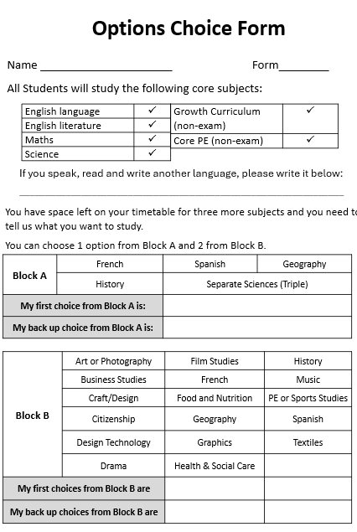
Whilst you can choose some of your GCSE subjects, you must continue to study:
English
Mathematics
Science
Growth (not examined)
Core PE (not examined)
Discussion → why do you think it is compulsory to study these subjects?
Why is there a focus on PE?
Why is there a focus on Growth?
________________________________________________________________________________________________________________
_______________________________________________________________________________________________________________
________________________________________________________
________________________________________________________________________________________________________________________________________________________________________
Why do you need a reserve?
Can you just tick the choices? Why not?
__________________________________________________________________________________________________________________________________________________________________________________________
Next step:
Fill out your practice options form with your first instinct of choices.
Explain why you picked those choices to a partner or your teacher.

Slide 14
Explain your option choices – you are justifying your choice to the teachers of the subjects and saying why you will be an asset to their class.
Choices | Reasons why / justification
1
2
3
3 reserve choices A B C

Slide 15
Options Choice Form
Name _____________________ Form________
All Students will study the following core subjects:
English language | ✓
English literature | ✓
Maths | ✓
Science | ✓
Growth Curriculum (non-exam) | ✓
Core PE (non-exam) | ✓
If you speak, read and write another language, please write it below:
_______________________________________________________________
You have space left on your timetable for three more subjects and you need to tell us what you want to study.
You can choose 1 option from Block A and 2 from Block B.
Block A | French | Spanish | Geography
 | History | Separate Sciences (Triple)
My first choice from Block A is:
My back up choice from Block A is:
Block B | Art or Photography | Film Studies | History
 | Business Studies | French | Music
 | Craft/Design | Food and Nutrition | PE or Sports Studies
 | Citizenship | Geography | Spanish
 | Design Technology | Graphics | Textiles
 | Drama | Health & Social Care
My first choices from Block B are
My back up choices from Block B are

